Slide 1
Week 12
Managing quality and performance (CHAPTER 19)
MN101 Principles of Management

Slide 2
Learning objectives
Explain why organisational control is a key management function.
Explain how the balanced scorecard addresses the four steps in the control process.
Explain how expense budgets and cash budgets are useful as management controls.
Discuss the use of financial statements and financial analysis as management controls.
Contrast the hierarchical and decentralised methods of control.
Describe the concept of total quality management (TQM) and major TQM techniques, including quality circles, benchmarking, Six Sigma principles, quality partnering and continuous improvement.
Describe the trends in quality and financial control.
Describe the qualities of effective control systems.

Slide 3
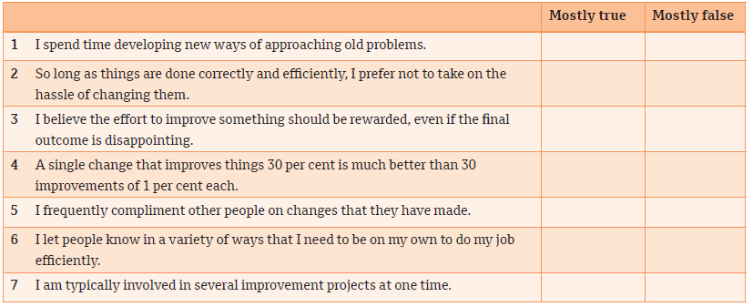
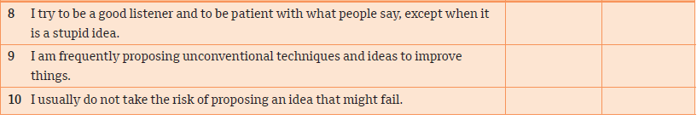
Improvement attitude
New manager self-assessment

Slide 4
1. The meaning of control
Organisational control refers to the systematic process of regulating organisational activities to make them consistent with the expectations established in plans, targets and standards of performance.
Effectively controlling an organisation requires information about performance standards and actual performance, as well as actions taken to correct any deviations from the standards.
Managers decide which standards, measurements and metrics are needed to monitor and control the organisation effectively and set up systems for obtaining that information.

Slide 5
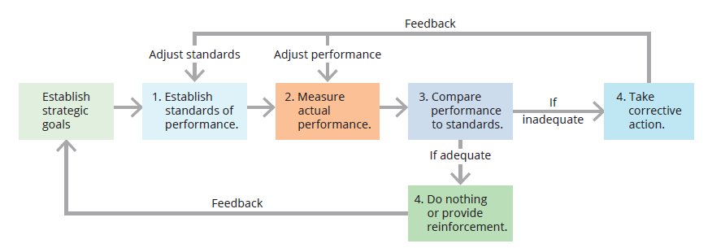
2. Feedback control model
Managers set up control systems that consist of the four key steps:
  Establish standards of performance.
  Measure actual performance.
  Compare performance to standards.
  Take corrective action.

Slide 6
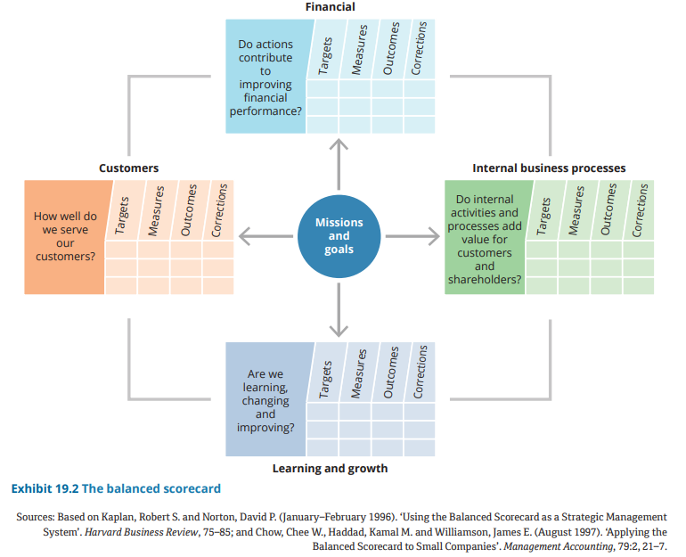
2. Feedback control model (cont.)
The balanced scorecard
The balanced scorecard is a comprehensive management control system that balances traditional financial measures with operational measures relating to a company’s critical success factors.
A balanced scorecard contains four major perspectives:
  financial performance
  customer service
  internal business processes
  organisation’s capacity for learning and growth.

Slide 7
3. Budgetary control
Every organisation, large or small, should prepare a financial budget that details the financial expectations (revenue and cost items) over the next 12 months.
Budgetary control is the process of setting targets for an organisation’s expenditures, monitoring results and comparing them to the budget, and making changes as needed.
The fundamental unit of analysis for a budget control system is called a responsibility centre.
A responsibility centre is defined as any organisational department or unit under the supervision of a single person who is responsible for its activity.

Slide 8
3. Budgetary control (cont.)
Expense budget
Outlines the anticipated and actual expenses for a responsibility centre
Revenue budget
Lists forecasted and actual revenues of the organisation
Cash budget
Estimates receipts and expenditures of money on a daily or weekly basis to ensure that an organisation has sufficient cash to meet its obligations
Capital budget
Lists planned investments in major assets such as buildings, heavy machinery or complex information technology systems, often involving expenditures over more than a year
Zero-based budget
A budgeting process that requires a complete justification for every line item in a budget
Top-down budgeting
A budgeting process in which middle- and lower-level managers set departmental budget targets in accordance with overall organisation revenues and expenditures specified by top management

Slide 9
4. Financial control
Financial statements
Financial statements provide the basic information used for financial control of an organization.
Two major financial statements are the starting points for financial control:
  The balance sheet shows the firm’s financial position with respect to assets and liabilities at a specific point in time.
  The income statement summarises the firm’s financial performance for a given time interval; it is a profit-and-loss statement.

Slide 10
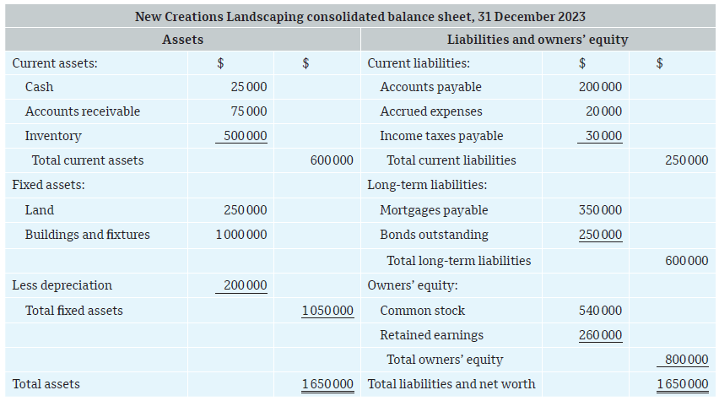
Balance sheet
4. Financial control (Cont.)

Slide 11
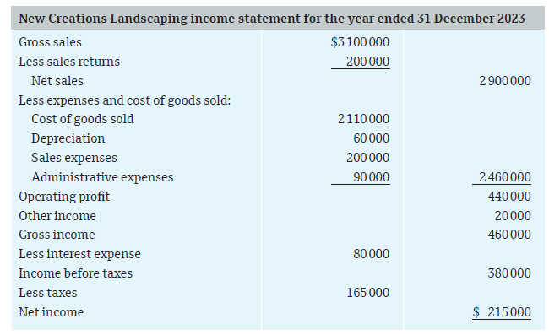
Income statement
4. Financial control (Cont.)

Slide 12
4. Financial control (cont.)
Financial analysis: interpreting the numbers
A manager needs to be able to evaluate financial reports that compare the organisation’s performance with earlier data or industry norms.
The most common financial analysis focuses on ratios: statistics that express the relationships between performance indicators such as profits and assets, sales and inventory.

Slide 13
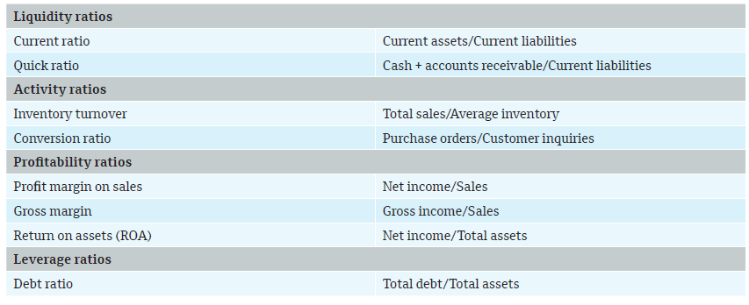
Common financial ratios
4. Financial control (cont.)

Slide 14
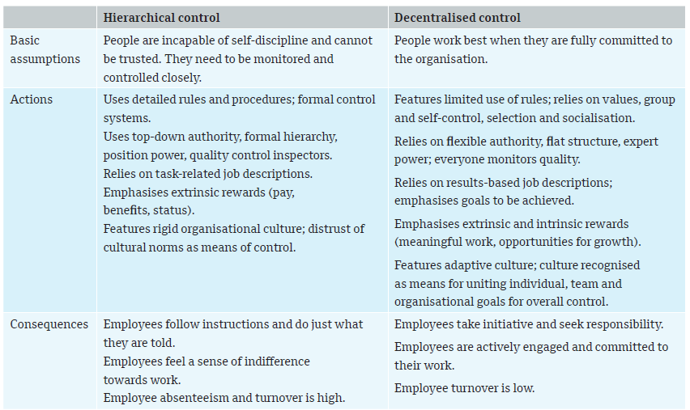
5. The changing philosophy of control
Hierarchical versus decentralised approaches
Hierarchical control: monitoring and influencing employee behaviour through extensive use of rules, policies, hierarchy of authority, written documentation, reward systems and other formal mechanisms.
Decentralised control relies on cultural values, traditions, shared beliefs and trust to foster compliance with organisational goals.

Slide 15
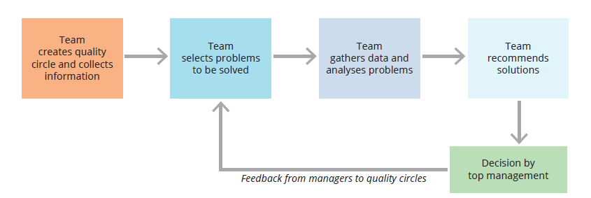
6. Total quality management (TQM)
TQM is a concept that focuses on managing the total organisation to deliver quality to customers.
Four significant elements of TQM are employee involvement, focus on the customer, benchmarking and continuous improvement.
The implementation of TQM involves the use of many techniques, such as:
  quality circles
  benchmarking
  Six Sigma principles
  quality partnering
  continuous improvement.
The quality circle process

Slide 16
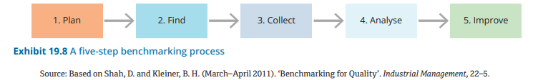
6. Total quality management (TQM) (cont.)
Benchmarking
The continuous process of measuring products, services and practices against major competitors or industry leaders
A five-step benchmarking process:

Slide 17
Total quality management (TQM) (cont.)
Six Sigma
  A quality control approach that emphasises a relentless pursuit of higher quality and lower costs
  Based on the Greek letter sigma, which statisticians use to measure how far something deviates from perfection
  A highly ambitious quality standard that specifies a goal of no more than 3.4 defects per million parts
Quality partnering
  Quality partnering involves assigning dedicated personnel within a particular functional area of the business.
  The quality control personnel work alongside others within a functional area, identifying opportunities for quality improvements throughout the work process. This makes it possible to detect and address defects early in the product life cycle.

Slide 18
Total quality management (TQM) (cont.)
Continuous improvement
The implementation of a large number of small, incremental improvements in all areas of the organisation on a continuing basis.
Based on the philosophy that improving things a little bit at a time, all the time, has the highest probability of success.

Slide 19
7. Trends in quality and financial control
One impetus for TQM in most industries is the increasing significance of the global economy.
Many countries have adopted a universal benchmark for quality management practices.
ISO 9000 standards are a set of international standards for quality management, setting uniform guidelines for processes to ensure that products conform to customer requirements.

Slide 20
8. Qualities of effective control systems
Effective control systems share the following traits:
Linkage to strategy
Understandable measures
Acceptance by employees
Balance of objective and subjective data
Accuracy
Flexibility
Timeliness
Support of action

Slide 21
Summary
Organisational control is the systematic process through which managers regulate activities to meet planned goals and standards of performance.
Most organisations measure and control performance using quantitative financial measures.
Feedback control provides valuable performance information that can be used to make effective decisions and improve processes.
Well-designed control systems include four key steps: establish standards, measure performance, compare performance to standards, and make corrections as necessary.
A balanced scorecard is a comprehensive management control system that balances traditional financial measures with measures of customer service, internal business processes, and the organisation’s capacity for learning and growth.
Budgetary control is one of the most commonly used forms of managerial control.
It is the process of setting targets for an organisation’s expenditures, monitoring results and comparing them to the budget, and making changes as needed.
An expense budget outlines the anticipated and actual expenses for a responsibility center.
The cash budget estimates receipts and expenditures of money on a daily or weekly basis to ensure that an organisation has sufficient cash to meet its obligations.
Budgetary control is one of the most commonly used forms of managerial control.
It is the process of setting targets for an organisation’s expenditures, monitoring results and comparing them to the budget, and making changes as needed.
An expense budget outlines the anticipated and actual expenses for a responsibility center.

Slide 22
Summary
The cash budget estimates receipts and expenditures of money on a daily or weekly basis to ensure that an organisation has sufficient cash to meet its obligations.
Financial statements provide the basic information used for financial control of an organisation.
The most common financial analysis focuses on the use of ratios – statistics that express the relationships between performance indicators such as profits and assets, sales and inventory.
Hierarchical control and decentralised control represent different philosophies of corporate culture.
Hierarchical control involves monitoring and influencing employee behaviour through extensive use of rules and other formal mechanisms.
With decentralised control, the organisation fosters compliance with organisational goals through the use of organisational culture, norms, and a focus on goals rather than rules and procedures.
Total quality management (TQM) is an organisation-wide effort to infuse quality into every activity in a company through continuous improvement.
The TQM philosophy focuses on teamwork, increasing customer satisfaction and lowering costs.
As global business expands, many companies have adopted a universal benchmark for quality management practices.
These include ISO 9000 standards, an international consensus of what constitutes effective quality management as outlined by the International Organization for Standardization (ISO).
Some key qualities of an effective control system are linking strategy, understandable measures, and having accurate, timely data that supports decisions and action, yet being flexible as needed so that controls will be reasonable and accepted by employees.

