Slide 1
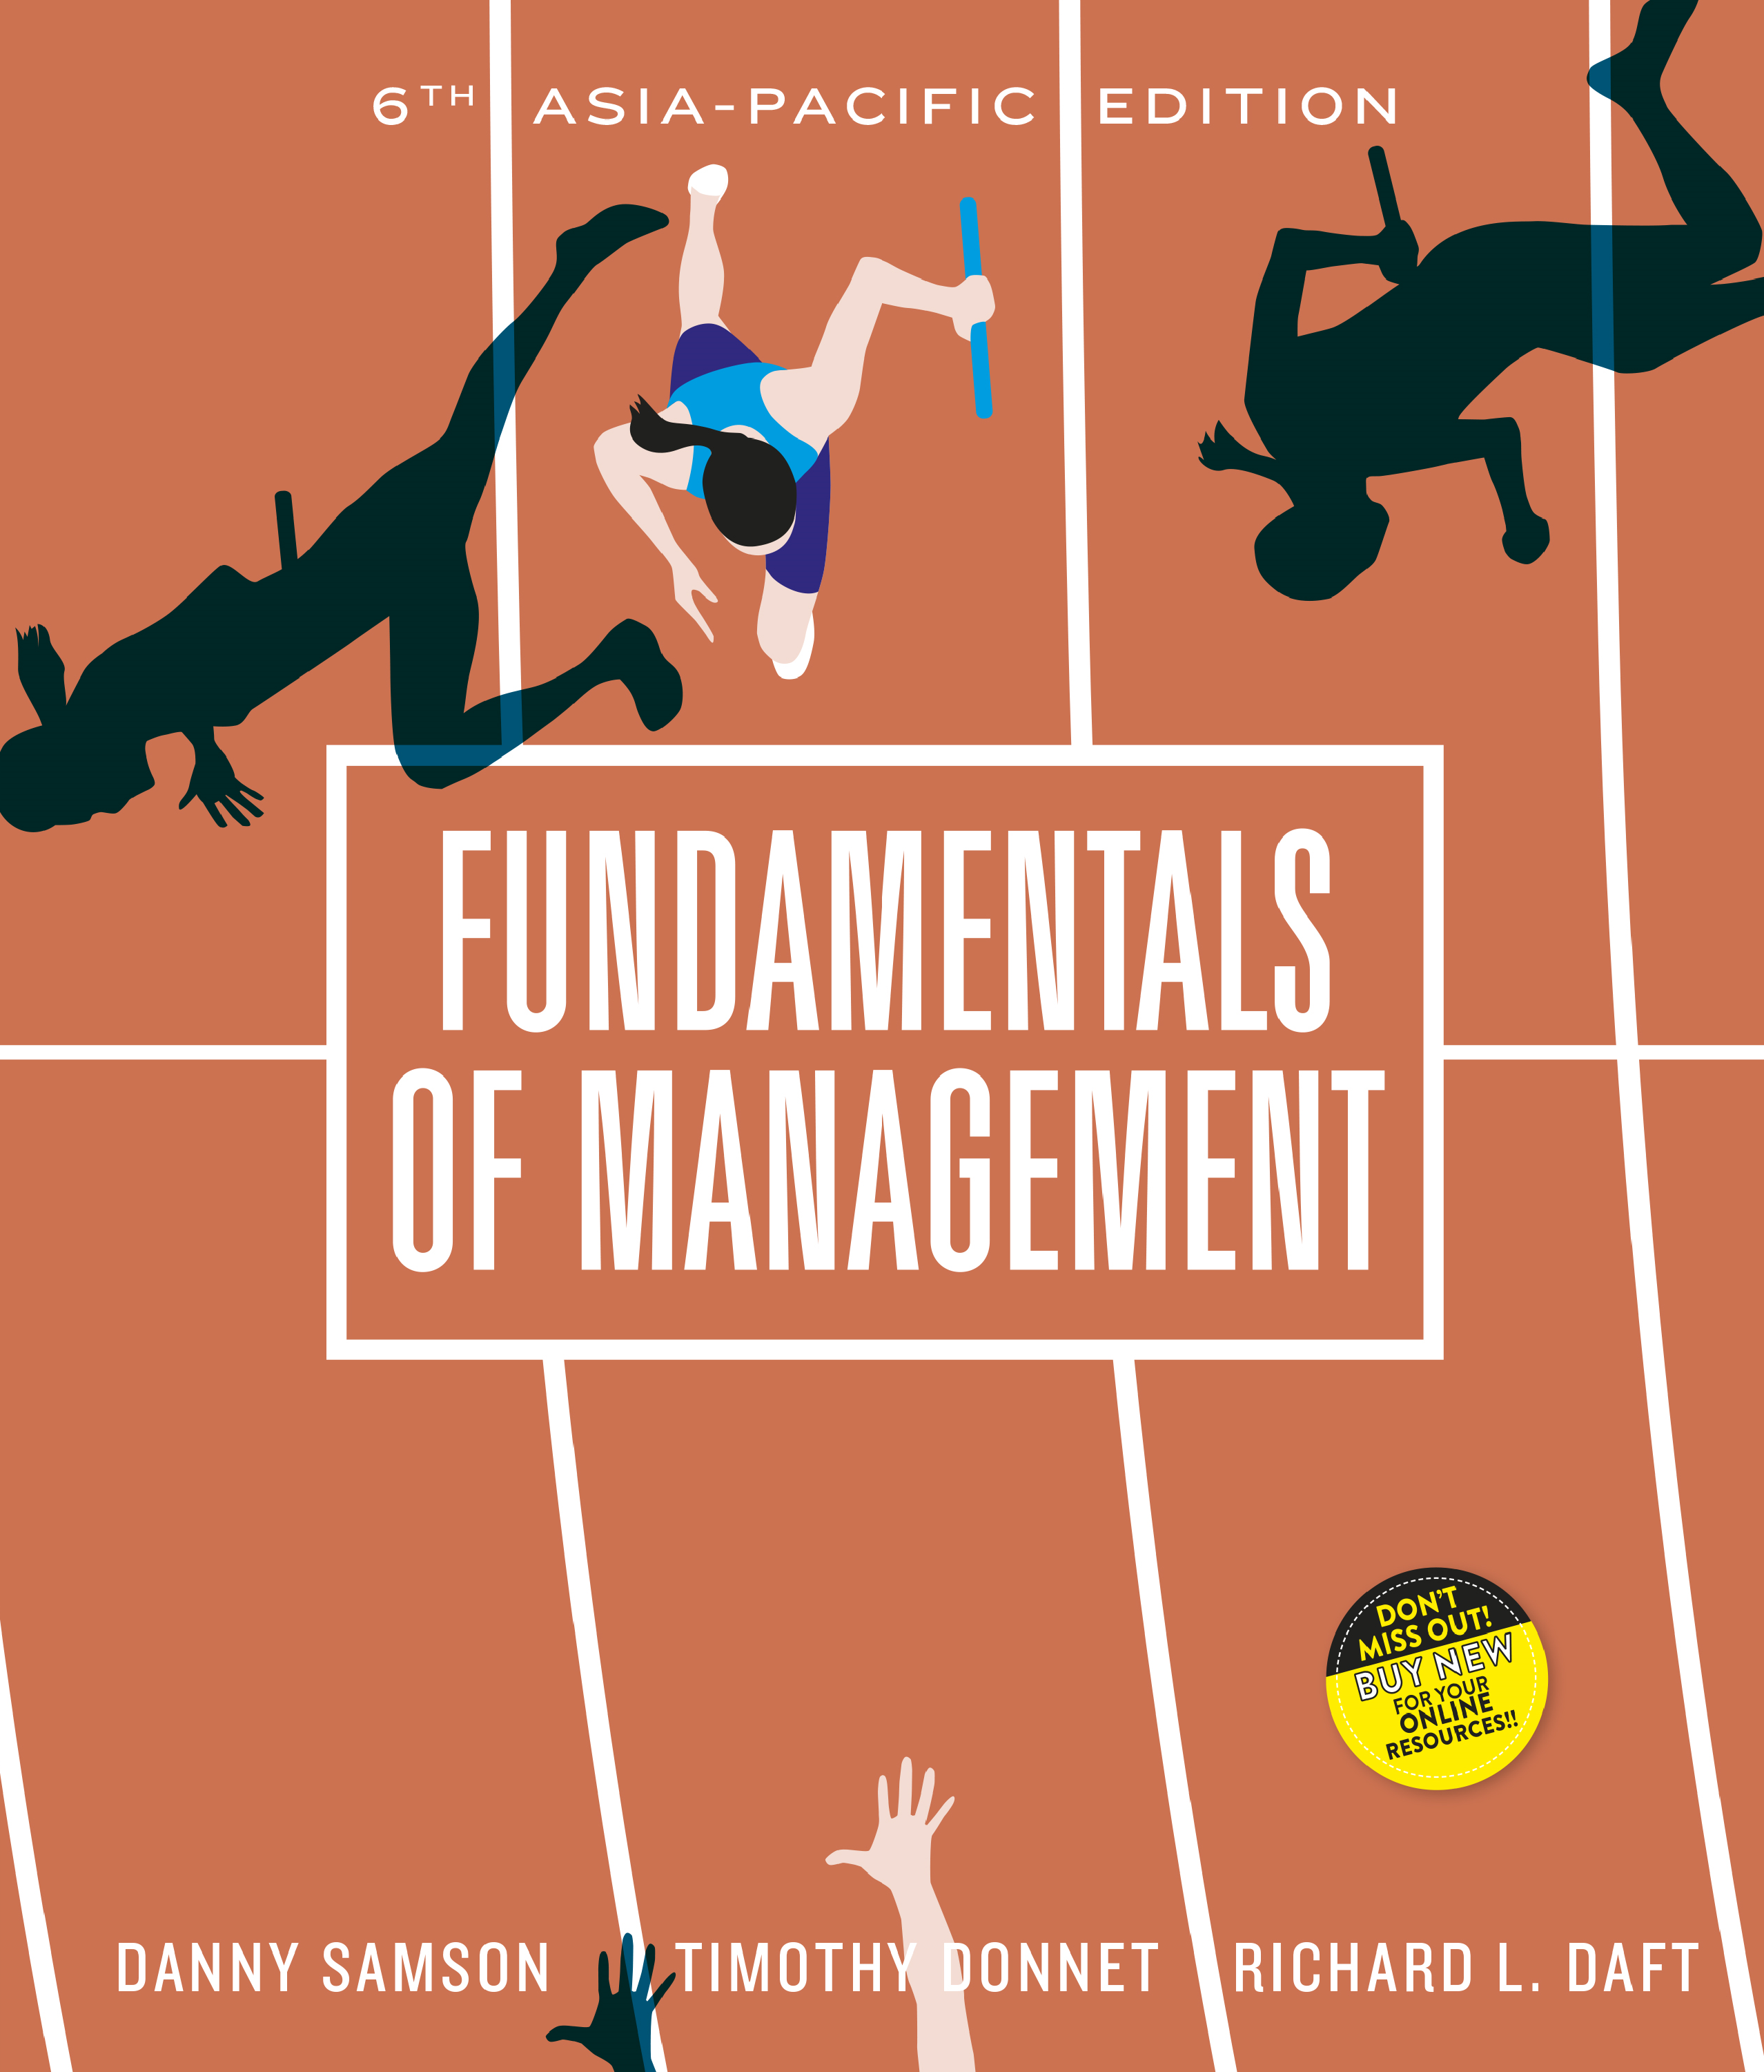

Slide 2
_{Chapter} ₁₄
Managerial and quality control

Slide 3
Organisational control
Refers to the systematic process through which managers regulate organisational activities to make them consistent with expectations established in plans, targets and standards of performance
Organisations need to ensure their financial and operational systems are well under control

Slide 4
Feedback control model
Control that focuses on the organisation’s outputs
Also called post-action or output control
Involves several steps

Slide 5
Steps of feedback control
4 key steps:
Establish standards of performance
  Standards relate to strategic goals
Measure actual performance
Compare performance to standards
Take corrective action

Slide 6
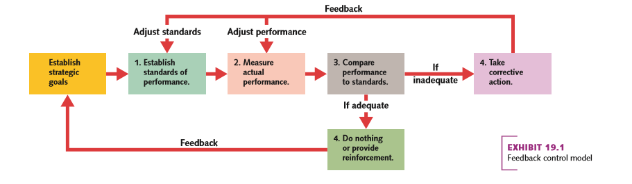
Feedback control model

Slide 7
The balanced scorecard
Is a management control system that balances traditional financial measures with operational measures relating to a company’s critical success factors
Is comprehensive

Slide 8
The balanced scorecard
Contains 4 main perspectives:
  Financial performance
  Customer service
  Internal business processes
  Potential for learning and growth

Slide 9
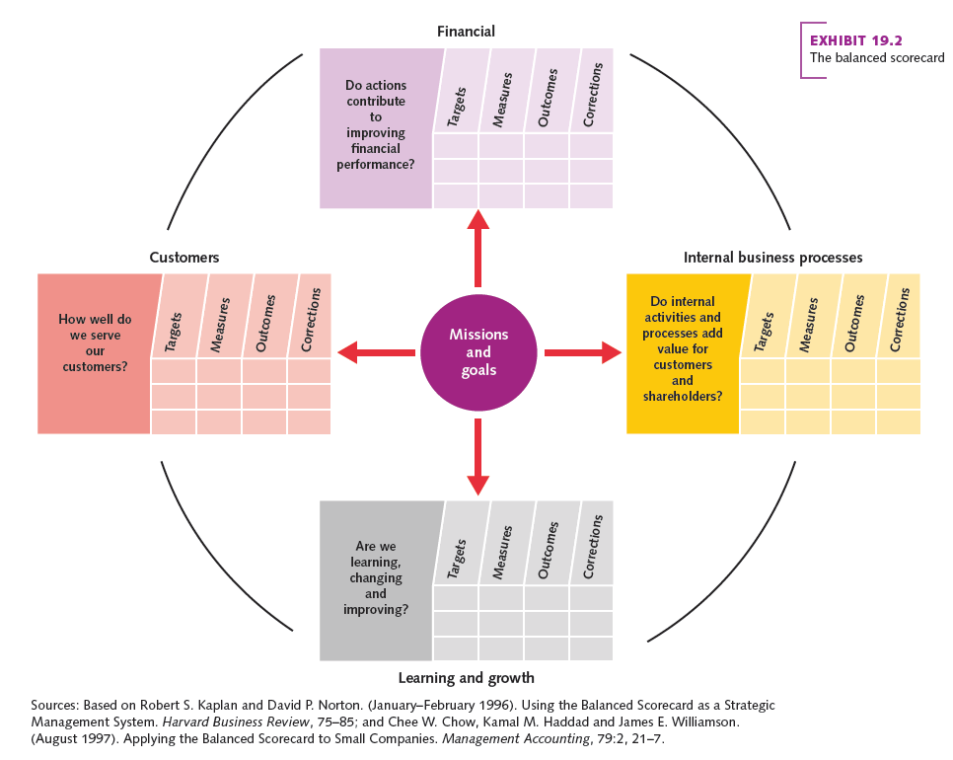
The balanced scorecard

Slide 10
Budgetary control
All organisations need to prepare financial budgets
Budgets detail the financial expectations of the organisation over the next 12 months
Commonly used:
  Expense budget
  Revenue budget
  Cosh budget
  Capital budget
  Zero-based budget (contd.)

Slide 11
Budgetary control contd.
Expense Budget
  Outlines the anticipated and actual expenses for a responsibility centre
Revenue budget
  Identifies the forecasted and actual revenues
Cash budget
  Estimates and reports cash flows on a daily or weekly basis
Capital budget
  Plans and reports investments in major assets to be depreciated over several years (contd.)

Slide 12
Budgetary control contd.
Budgeting is an important part of organisational planning and decision making
Top-down budgeting
  A budgeting process in which middle- and lower-level managers set departmental budget targets in accordance with overall organisation revenues and expenditures specified by top management
Bottom-up
  Process whereby lower-level managers budget their departments’ resource needs and pass them up to top management for approval
      More empowering

Slide 13
Financial control
Financial statements provide the basic information used for financial control
2 major financial statements:
The balance sheet
  Shows the firm’s financial position with respect to assets and liabilities at a specific point in time
Income statement
  Summarises the firm’s financial performance for a given time interval
  Also called a profit-and-loss statement

Slide 14
Financial analysis
A manager needs to be able to interpret and evaluate financial reports
Most financial analysis focus on ratios
  Showing relationships between performance indicators such as profits and assets, sales and inventory
Most common types:
  Liquidity ratios
  Activity ratios
  Probability ratios
  Leverage ratios (contd.)

Slide 15
Financial statements and analysis contd.
Liquidity ratio
  Indicates organisation’s ability to meet its current debt obligations (assets/liabilities)
Activity ratio
  Measures the organisation’s internal performance with respect to key activities defined by management (total sales/average inventory) (contd.)

Slide 16
Financial statements and analysis contd.
Profitability ratio
  Describes the firm’s profits in terms of a source of profits
    Sales or total assets
Leverage ratio
  Funding activities with borrowed money

Slide 17
The changing philosophy of control
Managers are adopting a decentralised rather than a hierarchical control process
Based on different philosophies of corporate culture
Most organisations have both hierarchical and decentralised control
Emphasis on one or the other type depends on:
  Organisational culture
  Managers’ beliefs about control

Slide 18
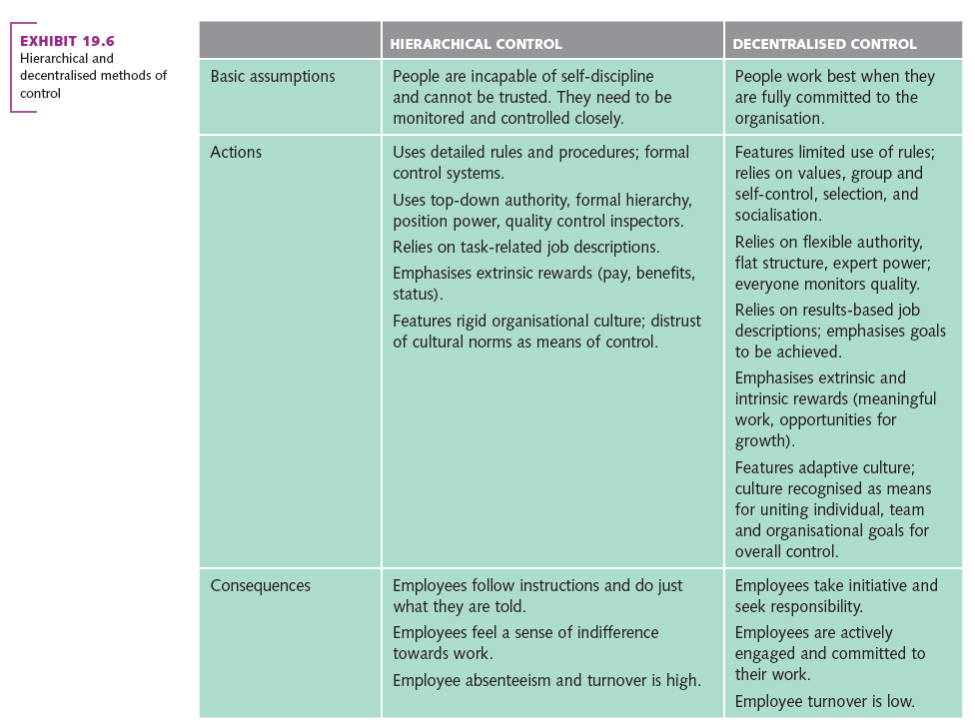
Hierarchical and decentralised methods of control

Slide 19
Open-book management
Sharing financial information and results with all employees in the organisation
A decentralised control system
Goal is to get every employee thinking and acting like a business owner
Not always favoured in some countries:
  Prevailing attitudes around secrecy and confidentiality

Slide 20
Total quality management
Refers to organisation-wide effort to infuse quality into every activity in a company through continuous improvement
Techniques include:
  Quality circles
  Benchmarking
  Six Sigma (contd.)

Slide 21
Total quality management contd.
Quality circles
  Group of six to 12 volunteer employees meet regularly to discuss and solve problems affecting the quality of their work
Benchmarking
  Continuous process of measuring products, services and practices against major competitors or industry leaders (contd.)

Slide 22
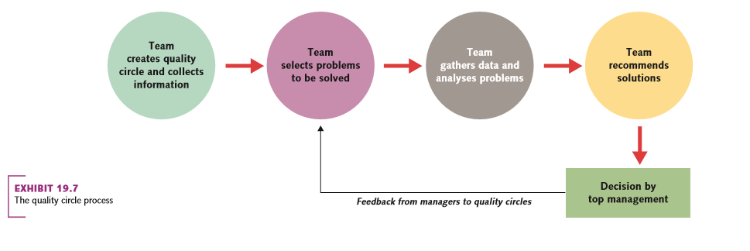
The quality circle process

Slide 23
Total quality management contd.
Six Sigma
A control approach that emphasises a relentless pursuit of higher quality and lower costs
Defect free 99.997% of the time
Requires major commitment from top management

Slide 24
International quality standards
A universal benchmark for quality management practices
ISO 9000
  Sets uniform guidelines for processes to ensure products conform to customer requirements
  A recognised standard for evaluating and comparing companies on a global basis

Slide 25
Corporate governance
Refers to the system of governing an organisation so that the interests of corporate owners are protected
Corporate failures on the scale of such as Lehman Bothers have made corporate governance a key concern for organisations

Slide 26
Qualities of effective control systems
Effective controls help managers respond to unforeseen developments and achieve strategic plans
Failure can lead to organisation’s demise

Slide 27
Qualities of effective control systems
Traits of effective control include:
  Linkage to strategy
  Understandable measures
  Acceptance by employees
  Balance of objective and subjective data
  Accuracy
  Flexibility
  Timeliness
  Support of action

Slide 28
Sustainable development and management control
Sustainability needs to be built into system
Focus on:
  Environmental
  Financial
  Social outcomes
Must be :
  Well planned
  Well resourced and
  Well controlled

