Slide 1

Is There a Chinese Diaspora?

Slide 2

Which groups do you think of when you hear the term “diaspora?”

Slide 3
Explore the concept of “diaspora” .
Explore the history and patterns of Chinese migrations in the framework of diaspora
Introduce “diaspora” as an explanatory paradigm (for understanding social and cultural phenomena)

Slide 4
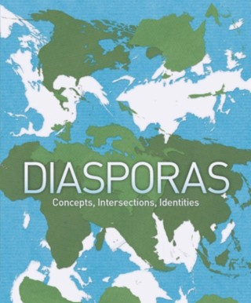
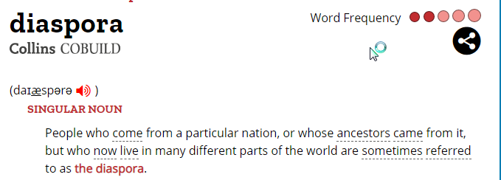
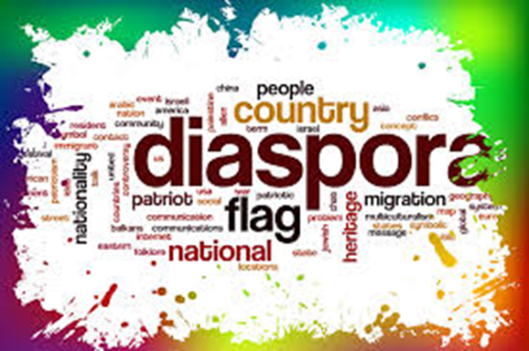
Diaspora?
Dia –”across”; sperien – “to sow or scatter seeds.”
Displaced communities of people who have been dislocated from their native homeland through the movement of migration, immigration, or exile.
https://www.collinsdictionary.com/dictionary/english/diaspora

Slide 5

Describe the concept of “diaspora” as currently used in social science today
2.Explore the history and patterns of Chinese migrations in the framework of diaspora
3. Introduce “diaspora” as an explanatory paradigm for understanding social and cultural phenomena

Slide 6
Merriam-Webster
Etymology: Greek, dispersion, from diaspeirein to scatter, from dia- +
speirein to sow
capitalized a: the settling of scattered colonies of Jews outside Palestine after the Babylonian exile b: the area outside Palestine settled by Jews c: the Jews living outside Palestine or modern Israel
a: the movement, migration, or scattering of a people away from an established or ancestral homeland <the black diaspora to northern cities> b: people settled far from their ancestral homelands <African diaspora> c: the place where these people live
Adjective: “Diasporic”
58

Slide 7
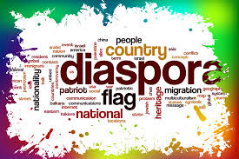
The classic diasporas
Jews
Armenians
Greeks
Africans
Basques

Slide 8
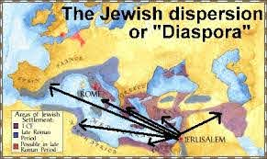
Deuteronomy 28:25,
"thou shalt be a dispersion in all kingdoms of the earth"
Psalms:146-147"The Lord doth build up Jerusalem: he gathereth together the outcasts of Israel".
Notes:
Its use began to develop from this original sense when the Hebrew Bible was translated into Greek;[13] the first mention of a diaspora created as a result of exile is found in the Septuagint, first in

Slide 9

God recognizes immigrants as uniquely vulnerable to injustice, alongside the fatherless and the widow
The Lord watches over the foreigner and sustains the fatherless and the widow (Psalm 146:9 NIV)
Thus says the Lord of hosts: “Execute true justice, Show mercy and compassion… Do not oppress the widow or the fatherless, the alien or the poor” (Zechariah 7:9-10 NKJV)
God commands His people to remember their own immigrant history
You must not oppress foreigners. You know what it’s like to be a foreigner, for you yourselves were once foreigners in the land of Egypt (Exodus 23:9 NLT)
When a stranger resides with you in your land, you shall not do him wrong. The stranger who resides with you shall be to you as the native among you, and you shall love him as yourself, for you were aliens in the land of Egypt (Leviticus 19:33-34 NASB)

Slide 10
What are the central elements of a classic diaspora?
“A people”
Shared culture
Homeland
Exiled
Return

Slide 11
Do these groups meet the definition?
Muslims South Asians Sikhs
Iranians British Filipinos
“A People” Shared Culture Exiled Homeland “Return”
Elements of a Diaspora

Slide 12

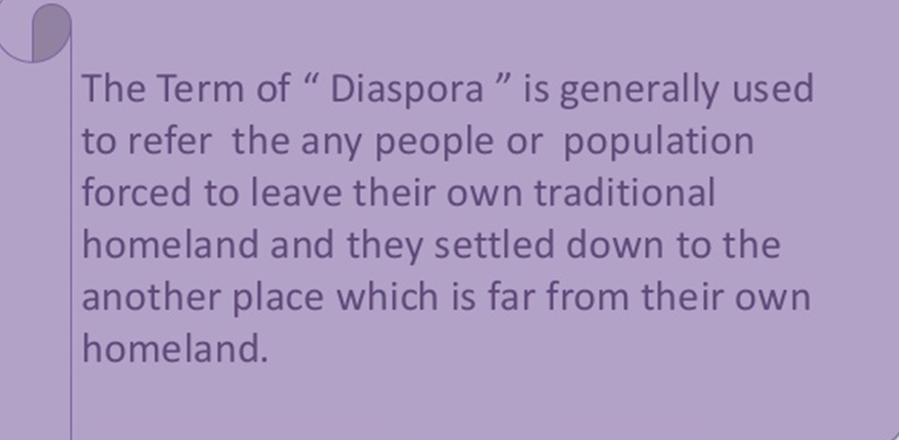

Slide 13
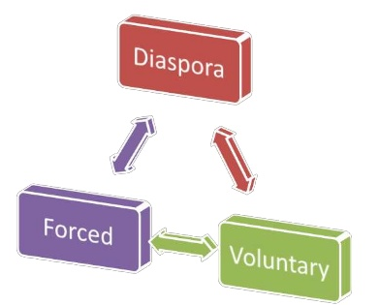
Different kinds of Diaspora
Victim(e.g. Jews, Africans, Armenians),
Labour (e.g. Indian, Chinese),
Trade (e.g. Chinese and Lebanese),
Imperial (e.g. the British),
Cultural diasporas.

Slide 14
What about a Chinese Diaspora?
Does it fit a pattern?
“A People”
Shared Culture
Homeland
Exiled
“Return”

Slide 15
Is there evidence in history of a Chinese diaspora?

Slide 16
Early Destinations
“Nan Yang” or “Southern Ocean”
Main receiving countries
Malaysia Singapore Indonesia Thailand
Other countries
Philippines Cambodia
Latin America
Peru 1849-1874
Cuba 1847
United States
California Gold Rush,1848-1852 Transcontinental Railroad,1862-1869

Slide 17
What about a homeland?
Chinese population movements in the 20th century largely originated from countries outside of China—Hong Kong, Taiwan, Singapore, Malaysia and Indonesia.

Slide 18
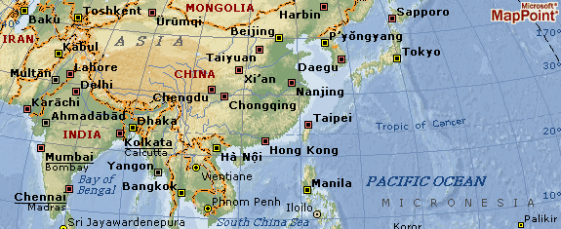
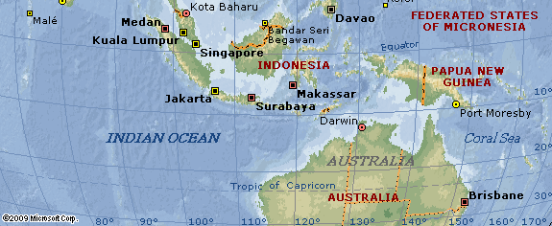

Slide 19
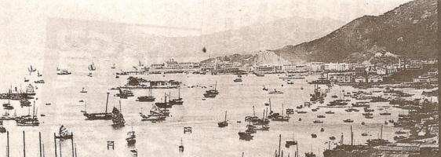
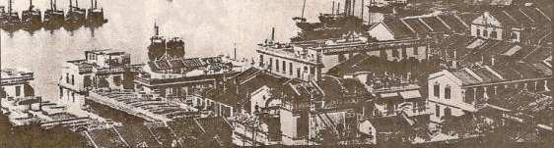
http://www.newworldencyclopedia.org/entry/Treaty_of_Nanking
Hong Kong in the 19th Century

Slide 20

Were Chinese exiled?
Pattern of Early Chinese Emigration
Men emigrated as workers for plantations and mines
Became merchants and craftsmen
Traded with China
Attracted new family members
Men returned to China for marriage.
Families sent sons to China to bring back wives.
Communities grew as middlemen for colonial powers

Slide 21
Do overseas Chinese community consider themselves as a diaspora?
After the revolution in 1911, the new Republic of China assigned the term “hua qiao” 华侨 for all “overseas” Chinese.
“By giving the phenomenon an elegant and respectable name, it gave sojourning a definite direction and a new purposefulness, and made it into a powerful political force in the 20th Century.” (Wang, G., 2000:54)

Slide 22
Who are the 华侨 (Hua Qiao)?
1949, the Republic of China (ROC) left the mainland.
The ROC refers to itself as the true China.
The ROC does not refer to those living in Taiwan as 华 侨 (hua qiao) but use the term for all other overseas Chinese.
The Chinese of Hong Kong and Macao also referred to themselves as 华侨 (hua qiao).

Slide 23
Who are the 华侨 (Hua Qiao)?
In 1997, Hong Kong was returned to People’s Republic of China (PRC)
The Chinese in Hong Kong wanted to retain 华 侨 (hua qiao).
P.R.C. refers to them as 同胞 (tong bao) or compatriot.

Slide 24
Do overseas Chinese meet the elements of a diaspora?
A people
Shared culture
Homeland
Exiled
Return

Slide 25
Is there a working definition of “diaspora?”
No consensus
Can refer to any social grouping
Replaces “minority” discourse
Metaphor

Slide 26
If there is no true definition of a diaspora,
why does it matter?
Diaspora as a descriptive term
Diaspora as a paradigm
Diaspora as an explanatory model for social phenomena

Slide 27
Do diaspora populations have to meet all of the elements?
“(M)etaphoric designations for several categories of people—expatriates, expellees, political refugees, alien residents, immigrants, and ethnic and racial minorities…” (Safran 1991:83).
Replaces or “…at least supplementing minority discourse” (Clifford 1994:31 ).

Slide 28
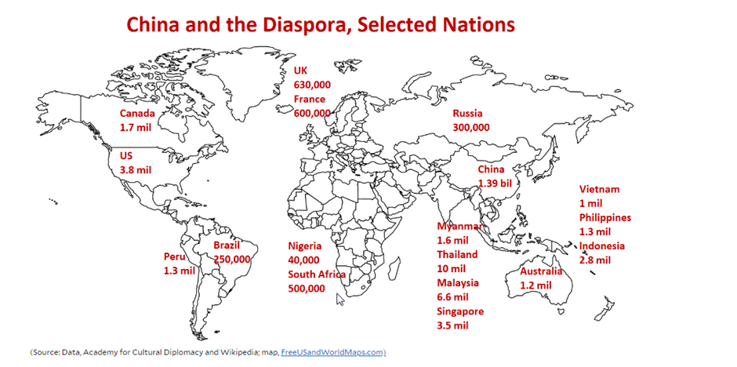

Slide 29
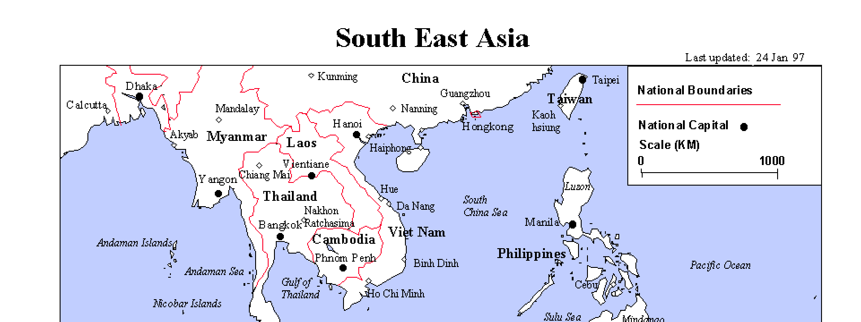
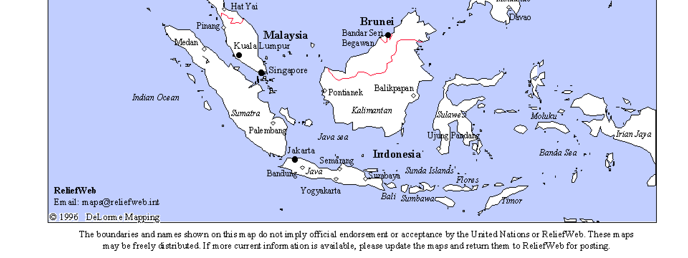
40

Slide 30
华侨 (Hua Qiao)?
1997, return of Hong Kong to the People’s Republic of China (PRC)
The Chinese in Hong Kong wanted to retain 华 侨 (hua qiao).
P.R.C. refers to them as 同胞 (tong bao) or compatriot.

Slide 31
Need for new terminology
Colonial and Cold War categories are obsolete-
East and West
Socialists and Democratic, and Non-aligned
First, Second and Third World
Developed, Developing and Underdeveloped Nations
North – South
Regional “Systems:” North Atlantic, Pacific Rim

Slide 32
So why is the term “diaspora” commonly used today?
Reduced importance of nation-state borders
Increase awareness of indigenous populations
Wider monitoring of world population movements
Expanded responses to refugees
Greater impact of migrant laborers
Growing role of ethnic and social networks on national and multi-national politics
Broader concern for oppressed groups
More frequent expressions of ethnic pride

Slide 33
Diaspora is a Useful Paradigm
Provides a sense of history
Links population through time (history) and space (location)
Brings to light political climate of minority populations within larger (host) populations

Slide 34
Diaspora as an Explanatory Model
Explains political processes and social movements
Populations will adopt the diaspora label to increase group solidarity and perceptions of political power.

Slide 35
Diaspora as an Explanatory Model
The strength and weakness of a diasporic community will fluctuate in response to political, cultural and economic pressures from the host and homeland societies and governments.
Explains external social and political pressures on minority groups
Host populations may attach the label to minority groups when seeking scapegoats.

Slide 36
“Diaspora” describes populations in the post-modern era
Globalization Transnationalism

Slide 37
Investment in Social Capital
A circulating network of people, trade goods and capital
Strong ties to the home village and kin
Continual rejuvenation of culture and social organization
Fostered solidarity in the immigrant community
Investment strategy that was based on social organization

Slide 38
Diaspora is an Approach
Historically based
Comparative
Cultural
Geopolitical
Community based

Slide 39
Do these groups meet all of our criteria?
Jews Greeks Basques
Elements of a Diaspora
Armenians Africans Chinese
“A People”
Shared Culture
Exiled
Homeland
“Return”

Slide 40
Do these groups meet the criteria diaspora?
Muslims South Asians Sikhs Hispanics
Iranians British Mexicans Filipinos

Slide 41
 | People | Shared Ancestry | Homeland | Exile | Dispersion
Jews
Armenians
Greeks
Africans
Basques

Slide 42
Limitations of the Paradigm
Not dynamic
Does not examine differences within groups.
Concept is too sweeping and broad
48

Slide 43
Diaspora as a political concept for group solidarity and political power.
“…at different times in their history, societies may wax and wane in diasporism, depending on changing possibilities—obstacles, openings, antagonisms, and connections—in their host countries and transnationally” (James Clifford 1994:306)

Slide 44
Are you a member of a diaspora?
Given what you know about the term, do you personally identify as a member of a diaspora?

Slide 45
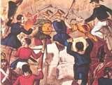
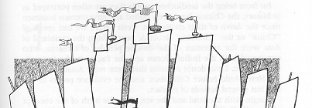
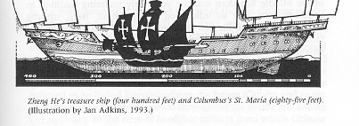
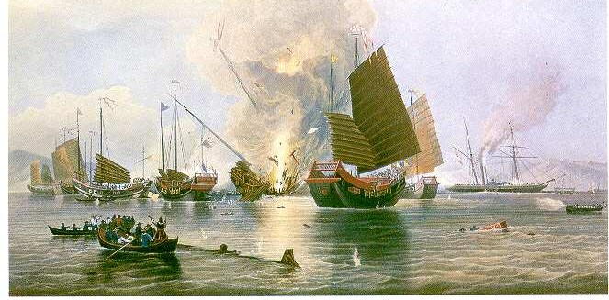
http://militaryhistory.about.com/od/battleswars1800s/p/secondopium war.htm
http://web.jjay.cuny.edu/~jobrien/reference/ob36.html

Slide 46
Bibliography
Clifford, James. (1994). “Diasporas,” Cultural Anthropology 9(3), pp. 302-338.
Leweling, Tara (2005). “Exploring Muslim Diaspora Communities in Europe through a Social Movement Lens: Some Initial Thoughts.” Strategic Insights, 4, no. 5.
Ma, Laurence J.C. (2003). “Space, Place and Transnationalism in the Chinese Diaspora.” In, Ma, Laurence J.C. and Carolyn Cartier, eds. The Chinese Diaspora: Space, Place, Mobility, and Identity. New York, NY: Rowman and Littlefield Publishers, Inc. pp. 1-49.
Safran, William, (1991). “Diasporas in Modern societies: Myths of Homeland and Return.” Diasporas: A Journal of Transnational Studies, 1 no.1, pp. 83-99.
Spence, Jonathan D. (1990) The Search for Modern China. New York, NY: W.W.Norton & Co.
Tololyan, Khachig (1996) “Rethinking Diaspora(s): Stateless Power in the Transnational Moment.” Diaspora 5, no.1, pp.3-35.
Tu, Wei-ming, ed. (1994). “Cultural China: The Periphery as the Center,” In, Tu, Wei-ming, ed. The Living Tree: The Changing Meaning of Being Chinese Today. Stanford, CA, Stanford University Press, pp. 1-34.
Wang, Gungwu. (2000). The Chinese Overseas: From Earthbound China to the Quest for Autonomy. Cambridge, MA: Harvard University Press.
Wang, L. Ling-chi. (1994). “Roots and the Changing Identity of the Chinese in the United States.” In, Tu, Wei-ming, ed. The Living Tree: The Changing Meaning of Being Chinese Today. Stanford, CA, Stanford University Press, pp. 185- 212.

