Slide 1
Chinese Diaspora in Modern World History
Africa

Slide 2
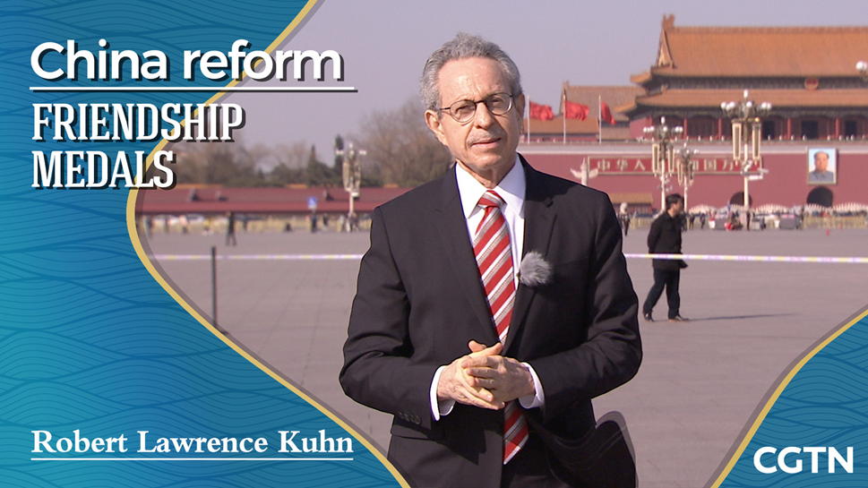

Slide 3
Africa (come criticisms of Kuhn!)
Kuhn's global focus presents narrative challenges.
On the one hand, Southeast Asia plays a major role in the story and is consistently examined by Kuhn across the early, colonial, and postcolonial eras.
But with mass emigration in the nineteenth century, the narrative necessarily extends beyond Southeast Asia, creating the problem of geographically and chronologically discontinuous listings of locations and their particularities.
Kuhn's nonlinear organizational framework permits a greater emphasis on fugue-like themes, variations, and comparisons across space that help readers navigate the local (and translocal) histories that comprise the global.
On the other hand, some significant areas, like Africa, escape mention altogether, a
understand, eg. the role that overseas Chinese communities in Africa have played in fostering China’s contemporary economic enterprises there

Slide 4
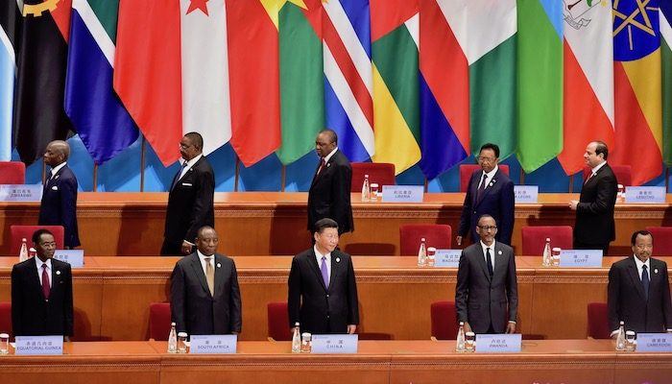
What China Is Really Up To In Africa (Belt and Road)
https://www.e-ir.info/2018/12/02/china-in-africa-a-form-of-neo-colonialism/
China in Africa: A Form of Neo-Colonialism?
https://www.forbes.com/sites/wadeshepard/2019/10/03/what-china-is-really-up-to-in-africa/?sh=56c64f1d5930

Slide 5
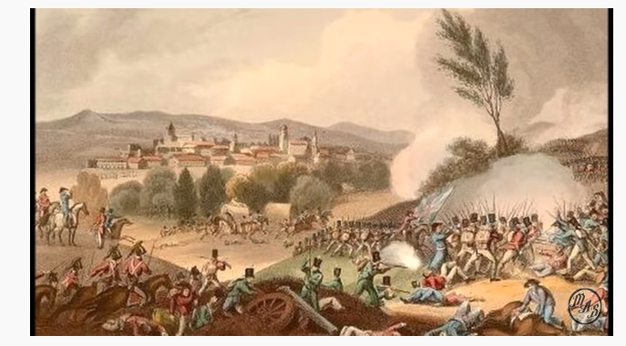
What Happened to the Chinese Explorers that Landed in East Africa? History of Chinese in Africa
https://www.youtube.com/watch?v=fUQa33Cs1m8

Slide 6


600 years of Chinese bloodline in Kenya
https://www.youtube.com/watch?v=IMFeZ6zhVUI
An African Chinese Descendant
https://www.youtube.com/watch?v=aORVMZX1pMw
https://www.youtube.com/watch?v=aORVMZX1pMw

