Slide 1
Chinese Diaspora in Modern World History
6: Revolution and "National Salvation"
The early 20th : New nationalism
Overseas Chinese identity and nationality,
Chinese ethnicity and state outreach in the context of state-building, national salvation, and revolution

Slide 2
New nationalism
By the early twentieth century there had developed a new nationalism that would structure ideas about overseas Chinese identity and nationality, as well as about Chinese ethnicity and state outreach in the context of state-building, national salvation, and revolution .
Chinese nationalism emerged by the early twentieth century and was accompanied by changes in China’s attitudes toward its overseas emigrants.
It is common knowledge that Chinese nationalism was embraced by the Chinese in the disapora.
the old-time regional/local focus remained strong in the pan–Chinese mobilization and the nationalism of overseas Chinese was different from that of those in China in intensity and vision. (agree??)

Slide 3

Malayan Jungle Patrol Aka Malaya Report (1953)
Malaya. British troops fighting communist rebels.

Slide 4
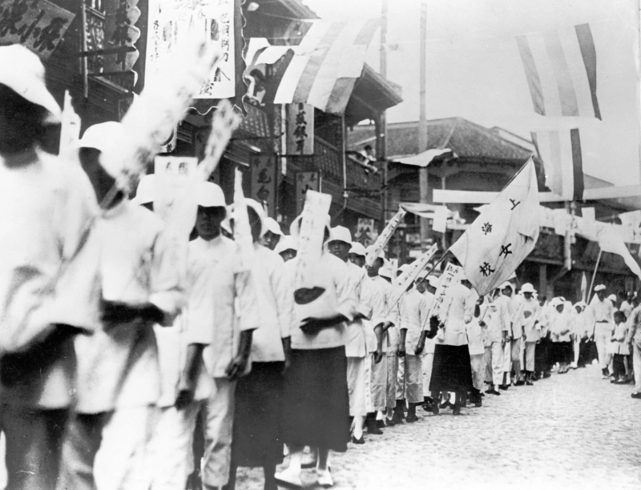
Down with the traitors !
Chinese students march with banners reading “Down with the traitors who buy Japanese goods” during demonstrations in Shanghai in 1919. SOVFOTO/UIG VIA GETTY IMAGES

Slide 5
Mainland and overseas Chinese
How 156 years of British rule shaped Hong Kong
https://www.youtube.com/watch?v=StW7oGSR_Mg
Is Taiwan a country... or part of China?
https://www.youtube.com/watch?v=KQTtwh2GRME
Are Hong Kong & Macau Countries?
https://www.youtube.com/watch?v=piEayQ0T-qA

Slide 6
Communism comes to Singapore
https://www.youtube.com/watch?v=MFdRUC670Zg
Feature History - Chinese Civil War
https://www.youtube.com/watch?v=jJr3KVM3lBo

Slide 7
Discuss : Chinese nationalism
Chinese nationalism
== “newly evident practices and symbols of ‘Chineseness’ (Chinese schools, newspapers, voluntary associations, and ritual practices) along with political activism related to China were obtrusive enough to cause resentment among indigenous peoples”(p. 354).
OR
it was anti-Chinese discrimination that made Chinese nationalism so popular in the diaspora???

Slide 8
Discuss
“…in the United States, the fear of Chinese was economic (depression of wages and slave labour)and political (unsuitability for American democracy)” (p. 234).
Chinese themselves generated anti-Chinese hostility.

