Slide 1
Semantics
Week 2, Chapter 2

Slide 2
Quiz
1. What is Semantics?
2. We could say syntax is a level below semantics. What is a level above?
3. What is the antonym of synonym?
4. What is a synonym of antonym?
5. Semiotics is the study of ____________?
6. Give examples of an icon _______
7. an index _________
8. and a symbol __________
9. The ability of languages to produce almost infinite combinations of sentences is called ____________.
10. Challenges to the definition theory of semantics include ___________, the accuracy of the definition and the context.

Slide 3
review
Questions and discussion of homework from p17 to 19. (1.1-1.6)
Main ideas of previous chapter, in the quiz…
Also 3 terms for levels of language:

Slide 4
One student look away

Slide 5
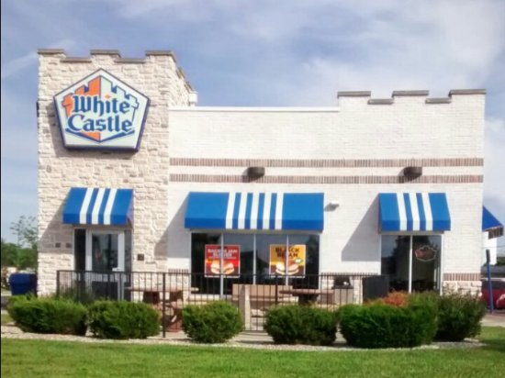
Chapter Two
Describe this picture:
Language can be used
to describe the world
How is this possible?

Slide 6
That hat is ridiculous!
I had a holiday in Albany
Picking out or identifying words is called referring/denoting
Referent/denotum
Sometimes denote is between linguistic expression and the world
And refer is the action of the speaker in picking out entities
Referring is what speakers do
Denoting is the property of words.

Slide 7
“Book” denotes things in the world with pages and writing etc.
“This book” refers to my Semantics book right here…

Slide 8
Referential (or denotational) approach
Vs
Representational approach
REFERENTIAL: Words are meaningful because they denote entities in the world, and sentences denote situations and events.
REPRESENTATIONAL “our ability to talk about the world depends on our mental models of it.”

Slide 9
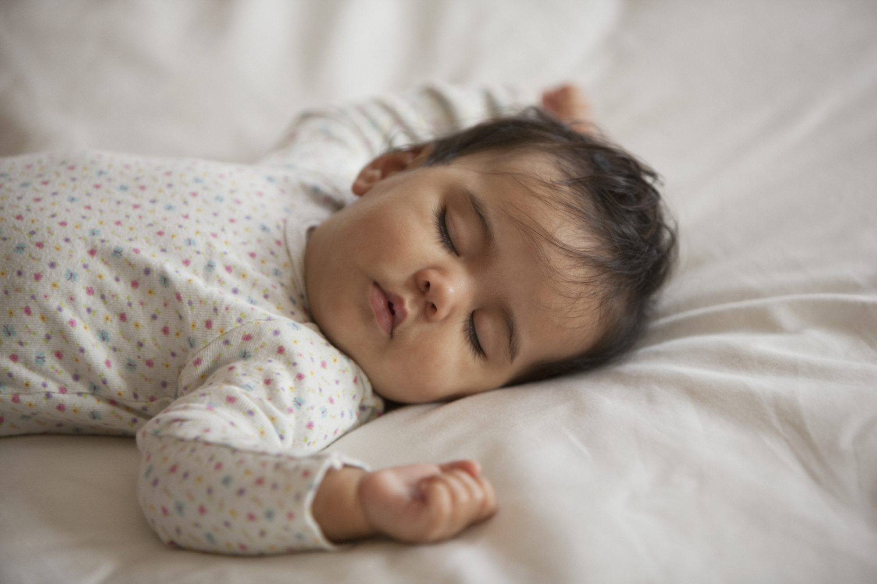
2.5

Slide 10
Examples 2.6 ff.
Also Tibetan TAM
Japanese pronouns etc.
Representational theories: “emphasize the way that our reports about reality are influenced by the conceptual structures conventionalized in language”
Referential theories: “meaning derives from language being attached to, or grounded in, reality.
Representational theories: meaning derives from language being a reflection of our conceptual structures

Slide 11
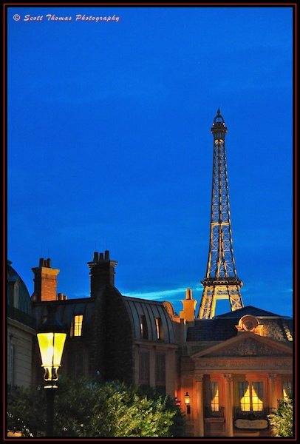
reference
Referring and non-referring expressions
  I gave him some apples.
  Apples are good for you.
Constant vs variable reference
  (draw one)
Referents and extensions
  (extensions show the denotations—
  That is, the set of things it could refer to)

Slide 12
Names
What does your name mean?
What does your full name mean?
What do you know about that person?
I know less. But I understand the meaning…
Description theory: “a name is taken as a label or shorthand for knowledge about the referent, or in the terminology of philosophers, for or more more definite descriptions.”
But this is dependent on associating the name with the right description.

Slide 13
NAMES
Causal theory: “names are socially inherited, or borrowed.”
There was an original “grounding” (competing names)
The name gets attached.
Sometimes competing names.
But this treatment can be extended to other names, like natural kinds.

Slide 14
Nouns and NPs
Indefinite and definite
Known to listener or not
Whoever fits the description
An account of reference has to deal with cases where there is no referent:
The King of France is bald.
Groups– either distributively or descriptively
Substances or abstract ideas

Slide 15
No student enjoyed my lecture.
Who is the referent?
Quantifiers

Slide 16
Reference as a theory of meaning
The simplest theory is to claim that
SEMANTICS IS REFERENCE
    Proper names denote individuals
    Common names “ sets of individuals
    Verbs “ actions
    Adjectives “ properties of individuals
    Adverbs “ properties of actions

Slide 17
Problems with this theory
Can you think of any?
Many words have no meaning
“If a speaker using these expressions is not referring to anything in reality, and such reference IS meaning, how do sentences (like that) have meaning?”
Not always a one to one correspondence between a linguistic expression and the item we want to identify.
So, the name and definite description refer to the same entity but do not have the same meaning, do they?

Slide 18
Think about this tautology (of Frege)
The morning star is the evening star.
And
Venus is Venus.
SO, (read the summary, page30), there is more to meaning than reference!

Slide 19
Frege’s Sense and reference
Sinn and Bedeutung
Sense is primary because it allows reference
The President of the USA→ we understand the sense
But who is it referring to?
Obama? Trump? Biden? (These are the references)

Slide 20
Mental Representations
Reference is important but there MUST be more than simply denotation.
A level of mental representation
A noun is said to gain its ability to denote because it is associated with something in the speaker’s/hearer’s mind.
But what are these mental representations?
The problem with common nouns…
Draw a car. Draw a house. Or describe it.
What about words like love, justice, or democracy
What about God?

Slide 21
What is this mental representation?
So it can’t just be an image, not purely visual, but a more abstract element: a concept.
Triangle
But unless we have a good idea of what “concept” is, we can get very empty definitions like “The sense of the word dog is the concept DOG.”
All this does is replace the term “meaning” with the term “concept”.

Slide 22
Concepts
So, if we use both theories and say “the meaning of a noun is a combination of its denotation and a conceptual element” then we have two qs:
1. What form can we assign to concepts
2. How do children acquire them, along with linguistic labels

Slide 23
Concepts with a single word: lexicalized
But there are also concepts which need a phrase or phrases.
Why?
Utility
New words like…
Words our family uses… why we even get new words in the first place.

Slide 24
Children’s concepts can differ from adults’ concepts
Underextending
Or
Overextending
give examples
Dog→Fido, Daddy→all adult males

Slide 25
Necessary and sufficient conditions
Using sets of conditions to define a word. Just the right amount.
Woman
OK
Let’s try with zebra or bird.
If we can’t establish a definition we agree with how can we label it linguistically?
Or words that we don’t really know the meaning of: hawk and falcon?

Slide 26
Still, we can use the words even if we don’t know a lot about the referent.
So you can use the words without having a set of necessary and sufficient conditions for the concept in your mind!
This is just a definition. So this is called definitional theory of concepts.
It relates to names (descriptive theory vs causal theory). It allows for speaker ignorance.
You can talk about Lhasa or Tibet.
“division of labor” in a speech community: between “expert” and “folk” uses of a term.

Slide 27
Sometimes only experts could explain the conditions of the concept but speakers don’t mind and keep using the word!
(some people find this annoying and try to correct folk usages/ignorance).

Slide 28
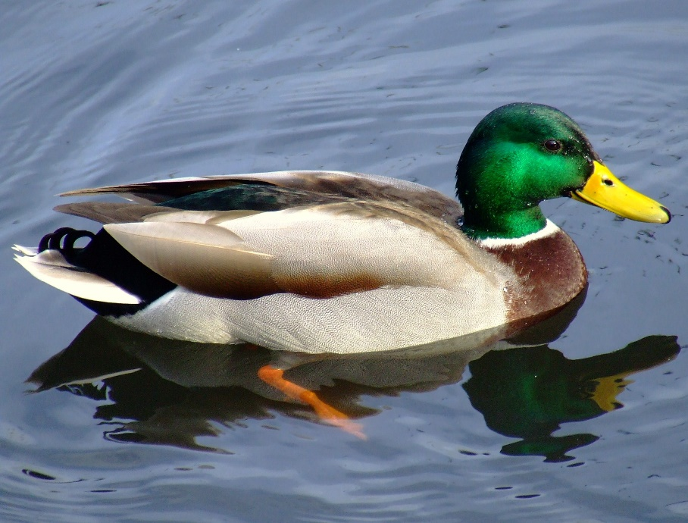
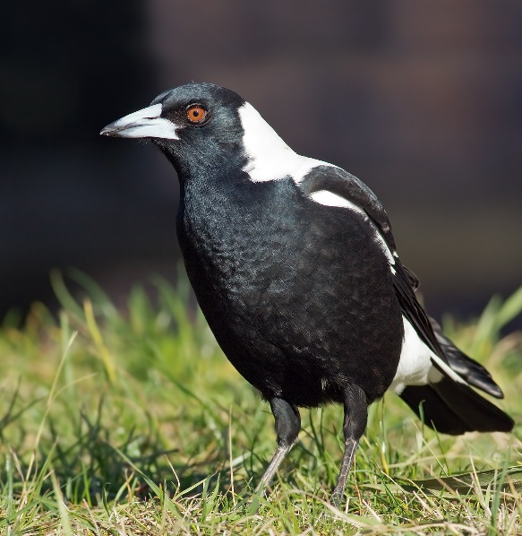
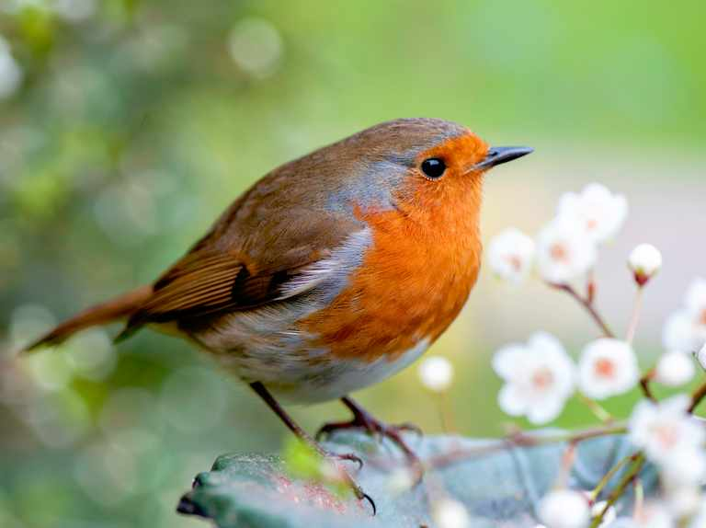
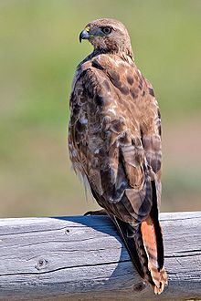
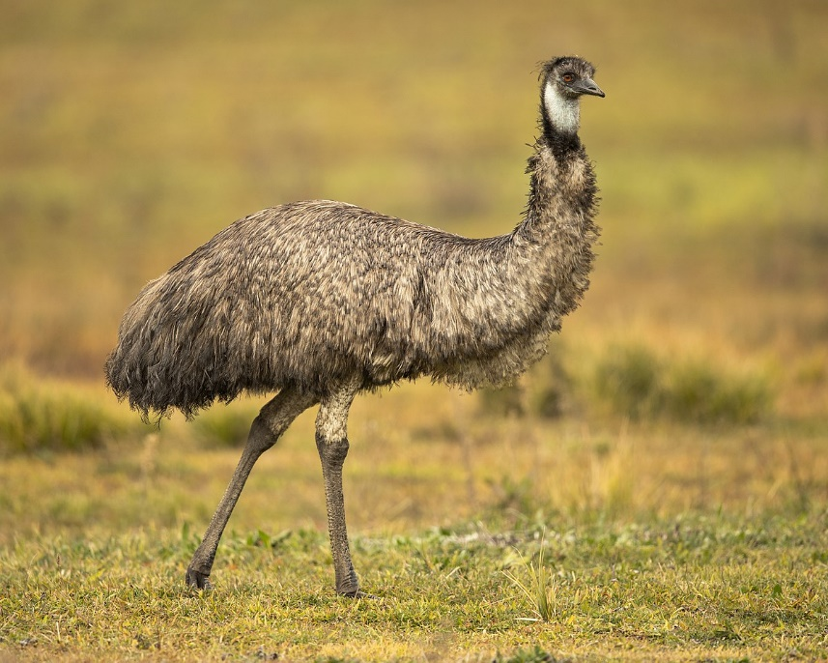
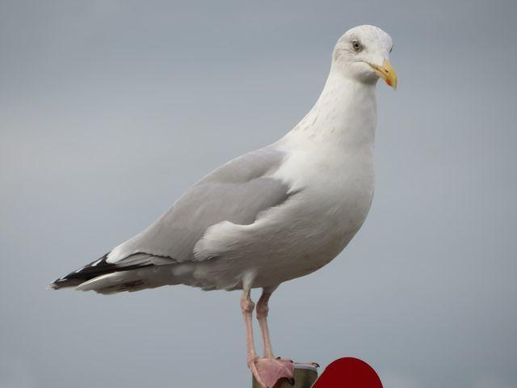
Which is the most “bird”?

Slide 29
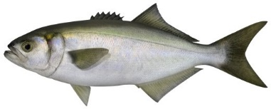
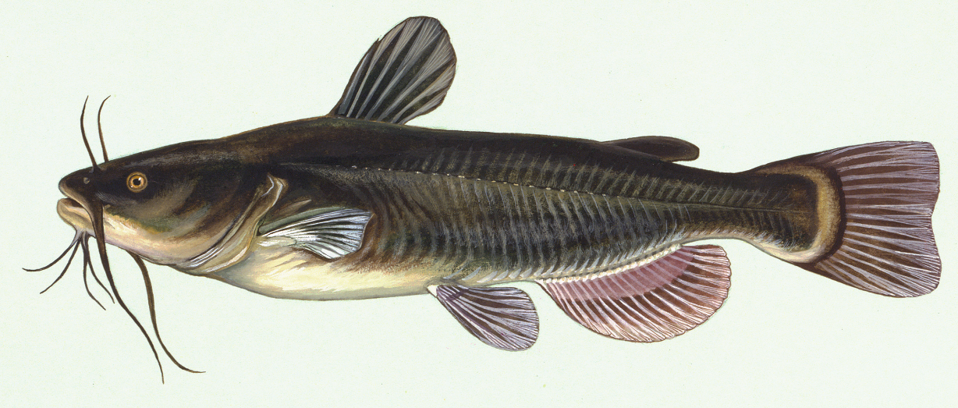
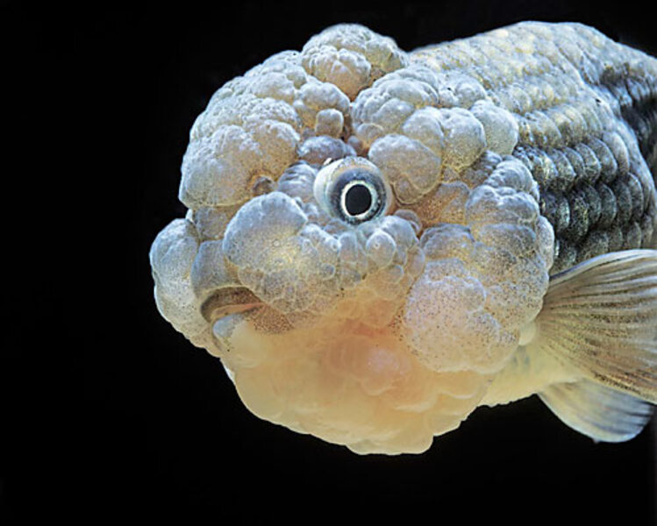
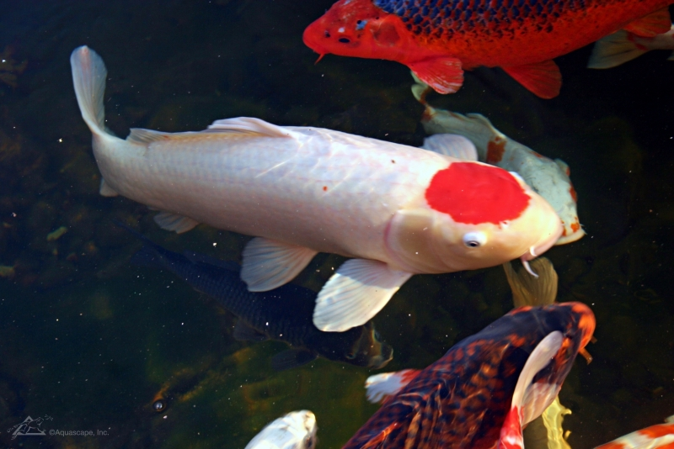
Which is the most “Fish”

Slide 30






Which is the most “Chair”?

Slide 31
Which is the most “Language”? “Country”?
Which is the most “mammal”?
The most “coffee”?
Tall?
Hot?
Jump?
Hit?

Slide 32
Prototypes
Mammal or fish test:
Characteristic features
Exemplars (memories to compare to)

Slide 33
Fillmore and Lakoff
“speakers have folk theories about the world, based on their experience and rooted in their culture.
Frames (Fillmore)
Idealized cognitive models (ICMs) (Lakoff).
Not scientific
Or logically consistent definitions
But collections of cultural views

Slide 34
Bachelor
What does it mean?
Some odd examples that fit that meaning.
We use both our semantic knowledge AND encyclopedic knowledge

Slide 35
Relationships between concepts
Words are in a network of semantic links with other words
The same goes for concepts
Sometimes all you know about a word is that it is related to a greater concept
“your knowledge of these concepts “inherits” knowledge you have” p36
So how much knowledge about a word do you have to have in order to use it?
Suggests “the crucial element is not the amount of knowledge but its integration into existing knowledge”

Slide 36
Conceptual hierarchies
Animal
Bird
Sparrow

Slide 37
How do Children (and adults) acquire concepts?
Ostensive definition
Acquiring concepts by being directed to examples in the real world.
Obviously…
However
Ngarang gi kabar angdra go be?
So even the ostensive definition depends on prior knowledge!
Are we born with certain basic concepts innately within us?

Slide 38
Words, concepts and thinking
What is the relationship between words and concepts?
Linguistic relativity: lexicalized concepts impose restrictions on possible ways of thinking
Language of thought hypothesis: maintains that while thinking and speaking are related, there are distinct levels of representation

Slide 39
Linguistic relativity
Associated with Sapir and Whorf
Check out the movie “Arrival”
Colors
“semantic gaps”
Put on/don
Single word with a long translation (Wayne’s World)
Familial relationships
etc.

Slide 40
Franz Boas, anthropological linguistics
Language mirrors culture
Then stronger idea
People’s thoughts are determined by the categories available to them in their language

Slide 41
The way we express and group words together under (seemingly) arbitrary concept groupings.
Classifiers
Dakota example
Famous book: Women, Fire, and Dangerous Things (Lakoff)

Slide 42
To what extent does the particular language we speak determine the way that we think about the world?
Read Sapir quote p 39
Do you agree?
I can think of things I have no word for!
It is condescending
What about that feeling of trying to explain something there is no word for?
Or take it even further: No two IDIOLECTS are ever sufficiently similar to be considered as representing the same INDIVIDUAL reality

Slide 43
Whorf called it linguistic relativity
Read his quote
Not just words
Also grammatical systems (which is even more determining)
But what about constantly changing language and even grammar?
How can we step outside?
What about metalanguages (even for describing languages?)

Slide 44
Rejected by cognitive science
It too strictly identifies THOUGHT and LANGUAGE
There is evidence of thinking without language
Linguistic analysis has shown that language underspecifies meaning
They propose a language of thought (propositional representations sans surface syntax)

Slide 45
Speakers compress thoughts
Hearers fill out their own version
Fits with idea that speakers are putting their thoughts into a language
(translation!)
This ‘language of thought’ is sometimes called Mentalese
It is proposed that the language of thought is universal.
Sum: “Human beings have essentially the same cognitive architecture and mental processes, even though they speak different languages.” p41

Slide 46
Thought and reality
“different theories of semantics often presuppose different answers to these very basic questions”
Leave some of it to psychology and philosophy (and religion!), focus on language.
P 42 quote: “it is more the task…”

Slide 47
Summary
Language can identify or refer to real world entities
BUT this isn’t a sufficient theory of meaning
Semantic knowledge includes both reference and sense
Two approaches for our ability to talk about the world:
Denotational—emphasizes links between language and external reality
Representational—emphasizes links between language and conceptual structure
Three linguistic Positions

Slide 48
Class Exercises/homework
ADD a lot to this for “Lab Work”
Make it practical and have them THINK thru it.

Slide 49
Classwork
How might a Korean/Japanese/etc. conceptual model of “home” differ from an Australian prototypical concept?
Do other languages have an equivalent to “home” and “house”? What is the difference in English and in X language?

Slide 50
Classwork
How might a Korean/Japanese/etc. conceptual model of “home” differ from an Australian prototypical concept?
Do other languages have an equivalent to “home” and “house”? What is the difference in English and in X language?
Light verbs in English. Empty verbs. Verbalizers. Is there a semantic basis for their grouping? Is there a grammatical basis?

Slide 51
Think of some words that commonly go together in English (or another language). Do they have different connotations? Are they different senses?
Brat, child
Toilet, rest room
Country town, regional centre
Underprivileged area, slum
Doctor, quack
Incident, accident

Slide 52
Think of some phrases or sentences that have no referent. (p26 R)
Can you compose “conceptual” content for words like democracy, punctuation, panorama, love, brown, zig-zag
Ouch!, me, you, this.
If, not, like, very.

Slide 53
Many phrases and sentences have a predictable relationship with a situation. How could we define these, by situation/context?
How are you?
Do you have the time?
Good luck.
Congratulations!
Have a nice weekend.
How about these situations: funeral, starting a class, ending a sermon, waking up, finishing eating,

Slide 54
Pour p47 R

