Slide 1
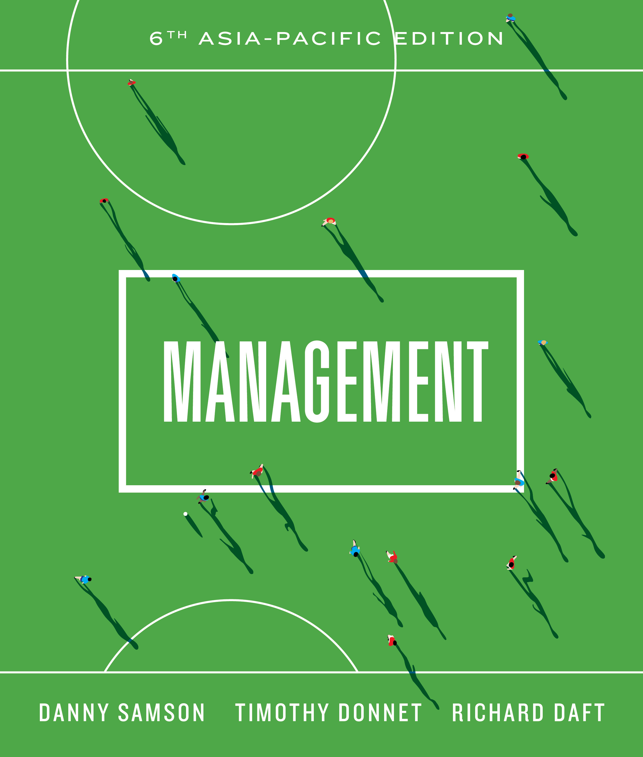

Slide 2
_{Chapter} ₁
The changing world of management

Slide 3
What is management?
What do you think?
Henry Fayol’s Principles of Management Video

Slide 4
Why innovative management matters
The world of management is changing
Innovation is important to maintain competitive edge in a hypercompetitive global environment
Organisations need to respond (more quickly than ever) to changing environment:
  By being innovative in products, services, management systems, production processes, corporate values and other aspects
Without innovation a company will NOT survive
Innovation Management Video

Slide 5
challenges in the workplace
Can be seen on Three Levels:
Challenges for Government
  Federal, state and municipal
  Limited resources and conflicting objectives entail trade-offs and other policy challenges
Challenges for Business
  Local and global competition
  Policy and other legal requirements
Challenges for individual employees
  Skills; job insecurity; careers

Slide 6
Managers who make a difference
Are aware of the challenges in today’s environment
Take a less traditional approach to management through:
  Flexibility and agility
    Embracing change
  Creating vision and cultural values.
  Fostering a collaborative workplace.

Slide 7
Management
Refers to the attainment of organisational goals in an effective and efficient manner
Makes use of four functions:
  Planning
  Organising
  Controlling
  Leading

Slide 8
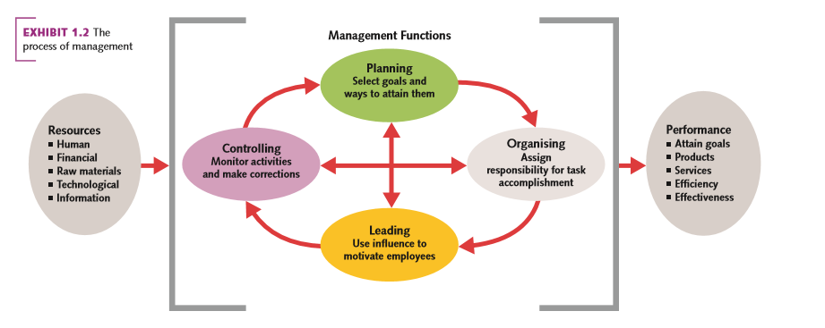
The process of management

Slide 9
The four management functions
Planning
  Defining goals for future organisational performance and deciding on the tasks and use of resources needed to attain them.
Organising
  Assigning tasks, grouping of tasks into departments and allocating resources to departments

Slide 10
The four management functions contd.
Leading
  Involves the use of influence to motivate employees to achieve the organisation’s goal.
Controlling
  Monitoring employees’ activities, keeping the organisation on track towards its goals, and making corrections as needed

Slide 11
Organisational performance
The organisation’s ability to attain its goals by using resources in an efficient and effective manner
  Organisation
    A social entity that is goal-directed and deliberately structured
  Effectiveness
    The degree to which the organisation achieves a stated goal
  Efficiency
    The use of minimal resources, raw materials, money and people, to produce a desired volume of output

Slide 12
Management skills
Conceptual skills
  Cognitive ability to see the organisation as a whole and the relationship among its parts
Human skills
  Ability to work with and through other people and to work effectively as a group member.
Technical skills
  The understanding of and proficiency in the performance of specific tasks

Slide 13
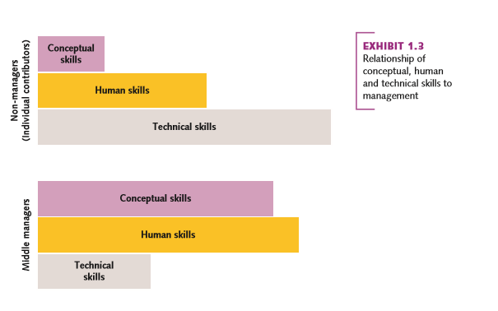
The relationship between the three skills

Slide 14
When skills fail
Failure can be devastating for both organisations and individuals or groups
  See example of Tony Hayward and the mishandling of BP oil spill into the Gulf of Mexico
Managers often make mistakes due to a variety of reasons:
  Demands of the rapidly changing environment.
  Poor interpersonal skills such:
    Poor communication
    Failure to listen
    Lack of team building in trust and respect.

Slide 15
Management types
Management jobs differ along:
Vertical differences
  Top managers
  Middle managers
  Project managers
  First-line managers
Horizontal differences
  Functional managers
  General managers

Slide 16
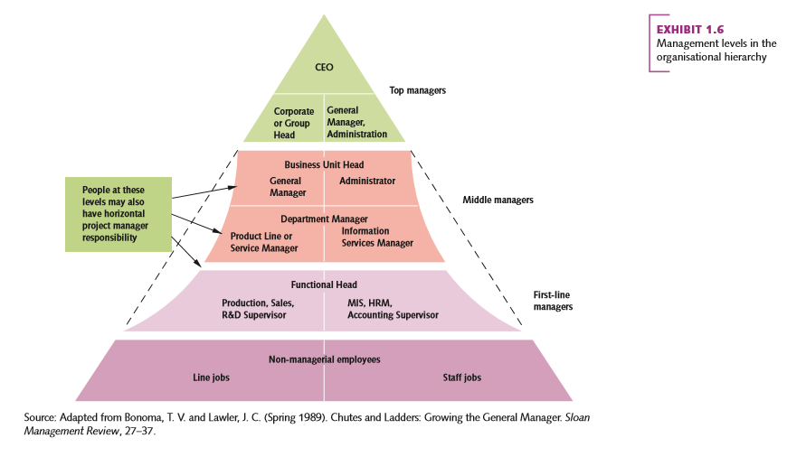
Levels of management

Slide 17
What is it like to be a manager?
A manager’s job is varied
Research by H. Mintzberg looked at differences in job characteristics and roles
Other research looked at what managers like doing
New managers often find the shift stressful
  Requires new set of skills
  Miss-matched expectations

Slide 18
Making the leap: becoming a new manager
Involves a new mindset
Involves acquiring more generalist skills required to lead, organise, and control resources

Slide 19
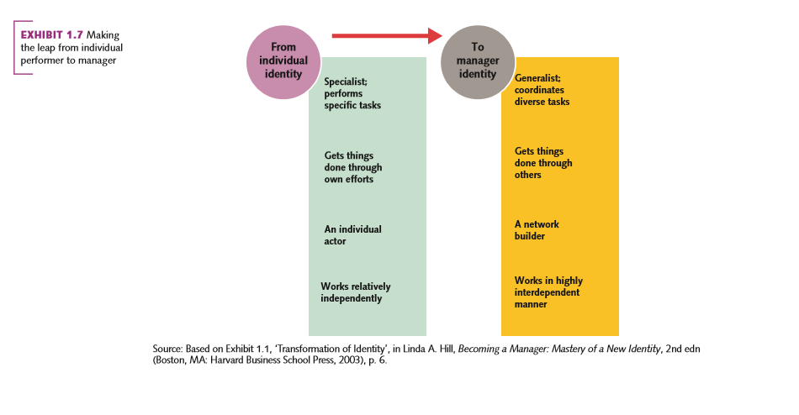
Making the leap: becoming a new manager

Slide 20
ManagerIAL activities
Managers perform a variety of tasks that are fragmented and often brief
  Life on speed dial
Managers require:
  Multitasking skills
  Time management to deal with unrelenting pace of work

Slide 21
Manager roles
Based on H. Mintzberg’s research:
  Informational
    Monitor, disseminator, spokesperson
  Interpersonal
    Figurehead, leader, liaison
  Decisional
    Entrepreneur, disturbance handler, resource allocator, negotiator

Slide 22
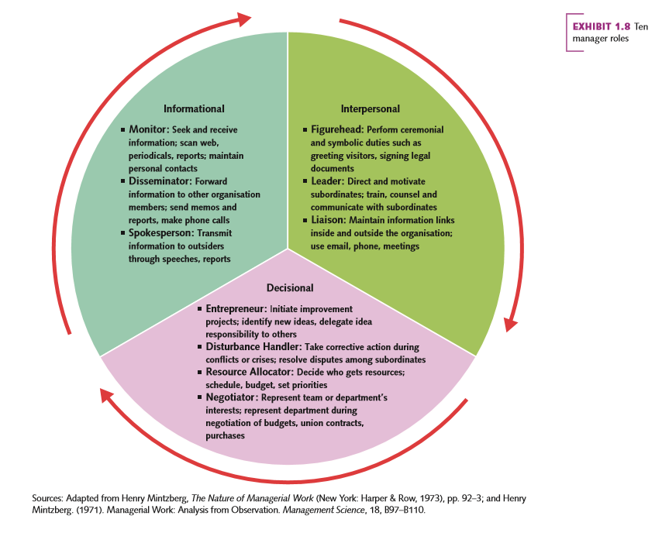
Ten manager roles

Slide 23
Managing IN small business and not-for-profit organisations
The need for effective and efficient management practices are needed in all organisations
The focus on which roles to focus on may differ
Profit-making organisations direct efforts towards earning money
Not-for-profit organisations focus on less tangible aspects that improve society in some way

Slide 24
State-of-the-art management competencies
Rapid changes in the environment requires new management competencies:
Less emphasis on control and more focus on empowering leadership
Increased emphasis on organisation designs that enable creativity, adaptation and innovation
Relationship management skills crucial:
  Working in teams
  Working with partner organisations around the world

Slide 25
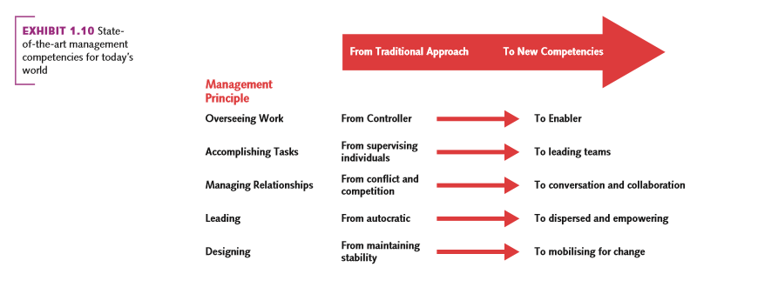
State-of-the-art management competencies

Slide 26
Turbulent times: managing crises and unexpected events
Globalisation has increased interconnection and interdependencies
Managers need skills to manage crises and unexpected events

Slide 27
Managing crises and unexpected events
Crisis management involves:
Staying calm
Being visible
Putting people before business
Telling the truth
Knowing when to get back to business

Slide 28
AUSTRALIA’S MANAGERS: IMPROVING FROM A LOW BASE
Sustainable development: is now a core issue for managers
  Effective and efficient management goes further than merely achieving the bottom line
Sustainable development practices benefit organisation, environment and society:
Emphasis on the ‘triple bottom line’ in terms of:
  Financial
  Environmental
  Social outcomes

