Slide 1


Slide 2
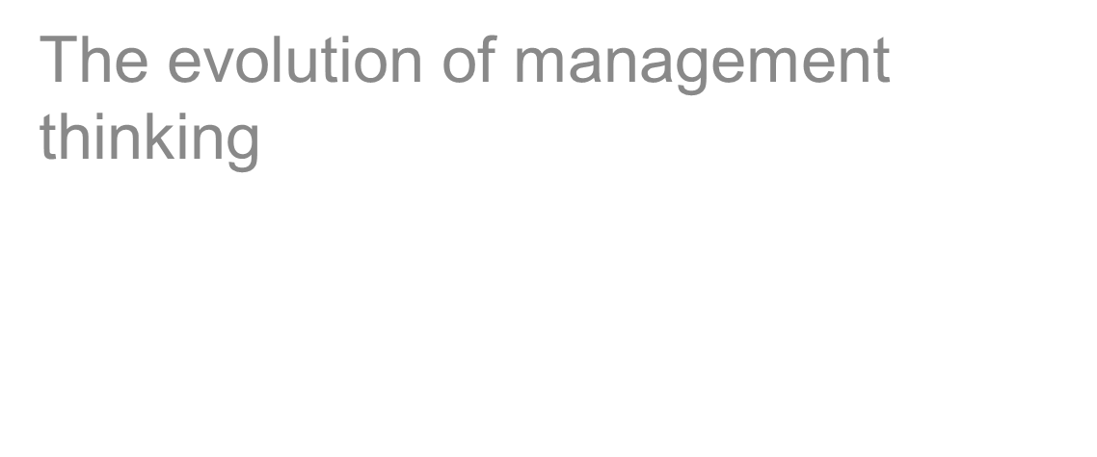
_{Chapter} ₂

Slide 3
Management and organisation
Understanding the historical foundation of management is useful for management education
  Managers learn from recognising and understanding past mistakes
  Management practices and perspectives change overtime in response to environmental factors such as social, political and economic forces

Slide 4
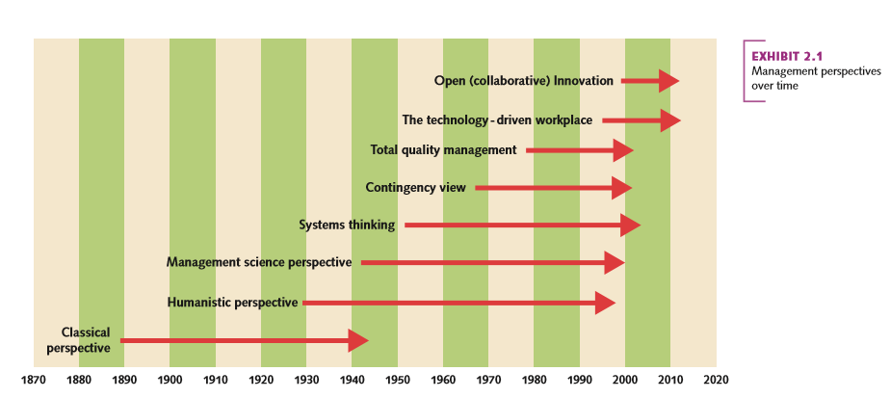
Management perspectives over time
Significant management thoughts can be drawn on a timeline:

Slide 5
Classical perspective
Emerged during the 19th and early 20th centuries as a response to new problems arising from industrialisation (environmental forces)
Has three (3) sub-fields:
  Scientific management
  Bureaucratic organisations
  Administrative principles

Slide 6
Scientific management
A sub-field of classical perspective
Key figure: F.W. Taylor (Father of scientific management)
Other key influencers include:
  Henry Gantt: Gantt chart
  Frank B. & Lillian M. Gilbreth: time and motion studies
Focus: improving efficiency and labour productivity
Scientifically study each job/task to determine the ‘one best way’ to do the work

Slide 7
Scientific management
Key principles:
  Develop standard method for performing each job
  Select and train workers
  Support workers (careful planning)
  Provide incentives (wages)
Scientific management ideas in use today:
  Standardised work methods
    Retail industry: re-engineering
    Use of technology to create efficiency and standardised products/processes

Slide 8
Bureaucratic organisations
Another sub-field of classical perspective
Originated by Max Weber
Focused on:
  Rational authority and formal structure
  Employee selection and advancement based on merit rather than ‘who you know’
  Rules and written records
  Authority based on position/legal power

Slide 9
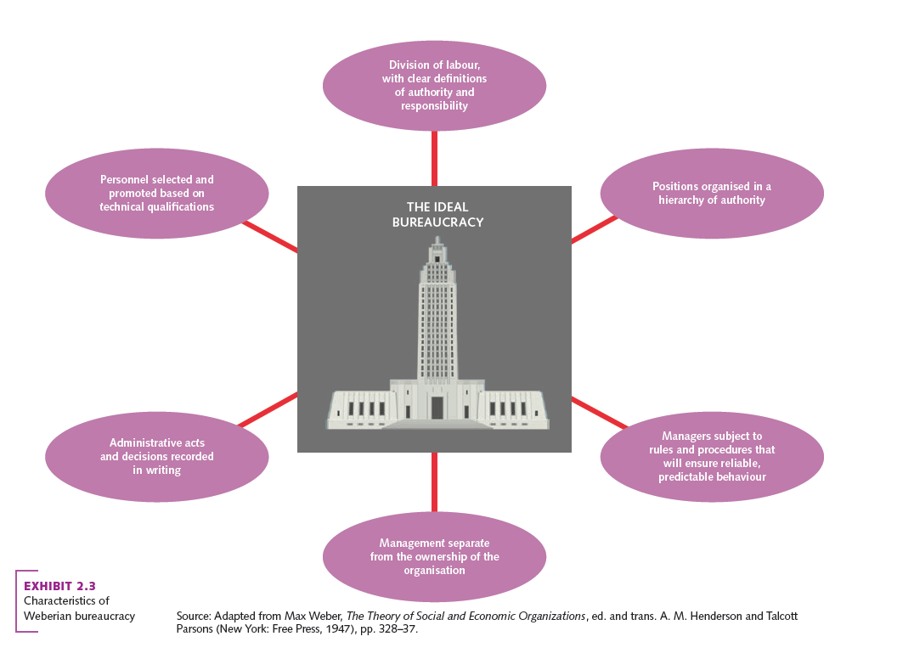
The ‘ideal’ bureaucracy

Slide 10
Administrative principles
The third sub-field of classical perspective
Focused on total organisation
Major contributor: Henri Fayol
Developed 14 principles of management
Conceived of 5 ‘rules’ of management (Contd.)

Slide 11
Administrative principles
Some of Fayol’s 14 principles influencing management thoughts and practices today include:
  Unity of command
  Division of work
  Scalar chain
  Unity of direction

Slide 12
Humanistic perspective
Emphasised the importance of understanding human behaviours, needs and attitudes in the workplace
Early advocates:
  Mary Parker Follett
  Chester Barnard

Slide 13
Human relations movement
Suggests effective control comes from within individuals, not adherence to strict, authoritarian control
Early response to social pressure for enlightened treatment of workers
Gained momentum from influence of the Hawthorne studies

Slide 14
The Hawthorne studies
Western Electric Company conducted a series of experiments to persuade businesses to increase lighting in work places
Hawthorne studies one of the most influential
Key figures: Elton Mayo and Fritz Roethlisberger
Highlighted positive link between humane treatment of workers and productivity

Slide 15
Human resources perspective
Further developed the idea of considerate leadership and worker participation
Combines prescriptions for job design and theories of motivation
Abraham Maslow
  Hierarchy of needs
Douglas McGregor
  Theory X and Theory Y

Slide 16
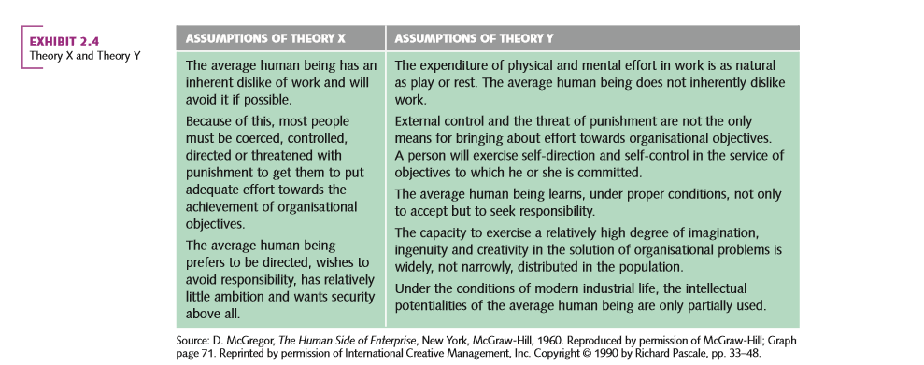
Theory X and Theory Y
Theories based on different underlying assumptions about human nature

Slide 17
The behavioural sciences approach
Applies social science in an organisational context
Makes use of scientific methods drawn from different fields such as:
  Sociology
  Economics
  Psychology
Notes:
NOTE: The remaining lectures/chapters focus on contributions under the behaviour science approach.

Slide 18
Management science
Emerged after WWII
Draws on:
  The application of mathematics, statistics and other quantitative techniques to managerial problems
  Operations research
    Mathematical model building
  Operations management
    Solve manufacturing problems
    (e.g. scheduling)

Slide 19
Recent historical trends
Systems thinking
Contingency view
Total quality management

Slide 20
Systems thinking
An extension of the humanistic perspective that describes organisations as open systems
Characterised by:
  Entropy
  Synergy
  Sub-system interdependence

Slide 21
Contingency view
What works in one situation may not work in another
Differs from classical perspective of universal concepts
  Each case is unique

Slide 22
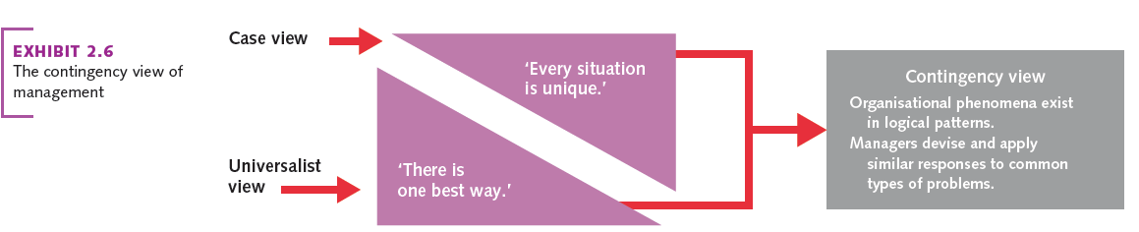
The contingency view of management

Slide 23
Total quality management
A concept that focuses on managing the total organisation to deliver quality to customers
Four significant elements:
  Employee involvement
  Focus on the customer
  Benchmarking
  Continuous improvement

Slide 24
THINKING FOR A CHANGING WORLD
Much of management work dependent on technology
  Doing business in the virtual world: E-business
  Requires knowledge management
  Use of social media to interact with customers, employees, shareholders, partners and other stakeholders

Slide 25
Sustainable development and management thinking
  Refers to the way in which organisations engage with and satisfy a wide variety of stakeholders
  Profit-making not the only focus
    Organisations need to pay more attention to safe-guarding finite resources and the physical environment
  A different and more enlightened way of treating customers
  Generally becoming more proactive in managing stakeholder relationships

